Slide 1


The Evolution From Public Administration to a New Public Management.
Libyan International Medical University
Faculty of Business Administration
By: fatima alzahraa agneaber
ID.3212 E-mail:fatemaalzahraa_3212@limu.eduly
1

Slide 2
Table of content:
Definition of public administration and public management.
Difference between public administration and public management.
The shift from public administration to a new public management.
Conclusion.
Reference.
2

Slide 3
Definition of public administration and public management:
Public administration: is a field in which leaders serve communities to advance the common good and effect positive change.
Public management:is a sub-discipline of public administration that involves conducting managerial activities in public organizations.
3

Slide 4
Difference between public administration and public management:
Public Administration vs. Public Management:public management comes under the public administration. Management deals only with managing the activities but administration deals with whole planning to budgeting. Administration acts as line agency where management as staff agency. Little difference but has big working analysis.
4

Slide 5
The shift from public administration to a new public management.
5

Slide 6
There are five phases of the evolution from public administration to a new public management.
6

Slide 7
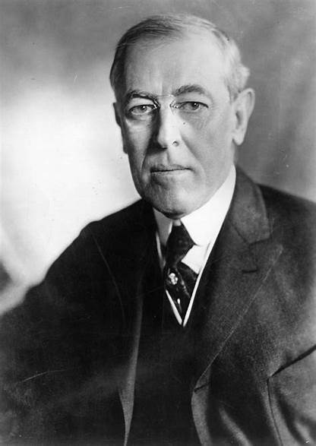
Woodrow Wilson’s “The Study of Administration” was the first to present the demand for separation between politics and administration was reinforced in the early twentieth century with the publication of Frank Goodnow’s book, “Politics and Administration: A Study in Government”
Phase 1
7

Slide 8
Phase 2
This phase tried to improve the industrial capability by increasing the output by simplifying jobs, pay by performed tasks, and create the alliance between the worker and manager.
8

Slide 9
Phase 3
This phase is called the golden age in the history of public administration. Because the aspect of intellectual practice of public administration peaked at this time. In this phase of public administration focuses only on increase of efficiency in administrative work.
9

Slide 10
Phase 4
NPM succed in accomplishing multiple goals among them increasing goverment efficiency improving services acces and delivery to citizens and downsizing goverment while expanding the private and nonprofit sectors.
10

Slide 11
Phase 5
New public governance is the formal and informal arrangements that determine how public decisions are made and how public actions are carried out, from the perspective of maintaining a country’s constitutional values when facing changing problems and environments. The principal elements of good
11

Slide 12
Conclusion:
New Public Management or NPM is an approach that seeks to build an administration by implementing flexibility, transparency, minimum government, de-bureaucratization, decentralization, the market orientation of public services, and privatization. It is a paradigm shift from traditional public administration to New Public Management.

Slide 13
Reference:
5 Phases Of The Evolution Of Public Administration. (n.d.). SCHOOL OF POLITICAL SCIENCE. Retrieved October 27, 2021, from https://schoolofpoliticalscience.com/evolution-of-public-administration/
What Is The Definition Of Public Management? (n.d.). The Answers Planet. Retrieved October 27, 2021, from https://theanswersplanet.com/what-is-the-definition-of-public-management/
The Classical Public Administrative Theory - 1158 Words | Bartleby. (n.d.). Fatima. Retrieved October 27, 2021, from https://www.bartleby.com/essay/The-Classical-Public-Administrative-Theory-PKQK78W3PT8X
Search. (n.d.). Master of Public Administration. Retrieved October 27, 2021, from https://mpa.unc.edu/search/node/The%20evolution%20from%20public%20administration%20to%20a%20new%20public%20management

Slide 14
Thank you!

