Slide 1



LIBYAN INTERNATIONAL MEDICAL UNIVERSITY
FACULTY OF BUSINESS ASMINISTRATION
Define Public Administration
Abdulhamid_2858@limu.edu.ly
Abdulhamid Elborki
2858
20/10/2021

Slide 2


Contents
Introduction
Definition of Public Administration
Example of public administration
Conclusion
References

Slide 3


Public administration is like any other administration which is carried out in public interest.
Introduction

Slide 4
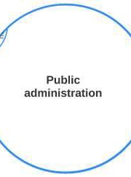
Definition of Public Administration
Public Administration is a detailed and systematic application of law. Public Administration consists of all those operations having for their purpose the fulfillment of public policy as declared by authority.

Slide 5


One can also say that public administration is nothing but the policies, practices, rules and regulation etc, in action.

Slide 6


Title
Example of public administration
Education
Post Office
Pubic Engineering
Public Health
Public Schools
Public Universities

Slide 7
Title:
Conclusion on Public Administration is a Science:
Thus there can be no doubt that Public Administration is a science. But it is to be understood that Public Administration is a social science like other social sciences, namely, Political Science, Economics, Ethics, etc.
Conclusion

Slide 8
References
Banerjea, S. (2016, March 8). Essay on Public Administration. Your Article Library.
MPA@UNC. (2021, July 29). UNC-MPA.

Slide 9


Slide 10
THANK YOU

