Slide 1


Business Ethics In The Context Of Globalization & Sustainability
Libyan International Medical University
Mohamed A.A Eldeep
Student Number : 2754
EMAIL : mohamed_2754@limu.edu.ly

Slide 2
Contents
Definition of Business Ethics
Globalization
Sustainability
globalization relation to sustainability ?
Conclusion

Slide 3

What is Business Ethics?
The study of proper business rules and procedures on potentially contentious matters such as corporate governance, insider trading, bribery, discrimination, corporate social responsibility, and fiduciary responsibilities is referred to as business ethics

Slide 4

Globalization
Globalization refers to the acceleration of global movements and exchanges (of people, goods, and services, capital, technologies, and cultural practices).

Slide 5
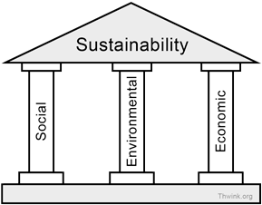
Sustainability
Sustainability focuses on meeting the needs of the present without compromising the ability of future generations to meet their needs

Slide 6
globalization relation to sustainability
In response to the effects of globalisation, a truly human and world-wide conception of sustainable development enables us to be more aware of the risks faced by humankind and the planet, and shows that a global and concerted form of regulation is both necessary and possible

Slide 7

Conclusion
Business Ethics is important for every organization since without there would be a lot of internal and external problems .

Slide 8
Refrences
Bapis fall 21 - Pompeu Fabra University. (n.d.). Retrieved October 24, 2021, from https://www.upf.edu/documents/235672946/244770599/BaPIS_ethicsglobal_F21.pdf/e9682b03-a5c2-faf9-9057-b75a6f916d65.

Slide 9


