Slide 1


Libyan International Medical University
Faculty of Business Administration
Identify The Changes in Marketing World
Nazeeha Abdelgader Amrouni
2763
Nazeehah_2763@limu.edu.ly

Slide 2
Content
2
What is marketing?
History of marketing .
Importance of marketing.
Identify the changes in marketing world.
Conclusion .
References .

Slide 3
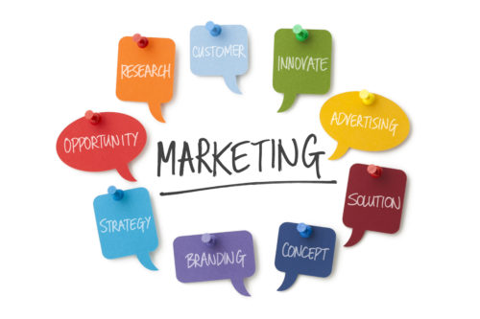
What is marketing ?
3
Marketing is the activity, collection of institutions, and procedures for developing, communicating, delivering, and exchanging value-added offerings for customers, clients, partners, and society as a whole.

Slide 4
History of marketing .
4
Marketing is currently renowned as a complicated mixture of strategy and technology, but it wasn't always that way. The modern history of marketing can be traced back to simple attempts to sell goods and services.
Attempts to do this may date back to the dawn of humanity. Some say it began with an attempt to show products in a certain way in order to facilitate trade. Since ancient China and India, people have been trying to produce convincing communications to sell goods and services. It's possible that this activity was not recognized as a marketing enterprise at the time, but it is where the idea for marketing started to develop.

Slide 5


Slide 6
Importance of marketing
6
Marketing Helps in Transfer, Exchange and Movement of Goods:
Marketing plays an important role in the transfer, trade, and mobility of goods. Customers can obtain goods and services through a variety of intermediaries, such as wholesalers and retailers. Both manufacturers and consumers benefit from marketing taining.
  : The Standard Of Living Of The Community
  Above all, marketing is about providing a standard of living to the community. “Marketing is the delivery of a standard of living,” says Paul Mazur. Professor Malcolm McNair went on to say, "Marketing is the production and delivery of a society's standard of living."

Slide 7
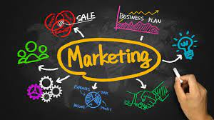

Slide 8
The changes in marketing world
9
Think back to about five years ago. Could you have predicted that we'd be riding in self-driving cars by now? That the average American checks their phone 8 billion times a day? Or that the CMO spends more money on IT than the CIO?
Ken Bernhardt, Regents Professor of Marketing Emeritus, Georgia State University, discusses what he believes to be the five biggest changes in marketing over the past five years , which include:

Slide 9
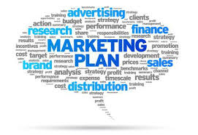
The changing consumer: This includes the rise and importance of Millennials, changes in purchasing behavior and the customer experience, and the fact that, thanks to mobile, the consumer has more information at his or her fingertips.
Marketing’s relationship with the CFO: Marketers need to produce ROI now more than ever. Our sense of responsibility has changed tremendously.
The explosion of new media: This means that marketers will have to learn how to appropriately deploy their resources across a wider range of media.
Another explosion in marketing technology and big data: has influenced a dramatic shift in the marketer's job, necessitating technological proficiency.
The rise of the customer journey and customer experience: provides a more limited perspective on how we sell goods and service.
10

Slide 10
Conclusion
11
The most thrilling of all corporate sports is marketing. It is the lifeblood of each successful company. It is always evolving as a result of the explosion of knowledge and the proliferation of technology at all levels and in all places.

Slide 11
References
12
(n.d.). Retrieved April 06, 2021, from https://www.hartehanks.com/insights/our-insights/2017/10/02/Blast-from-the-Past-What-Has-Changed-In-Marketing-from-5-Years-Ago-
Tracy, B. (n.d.). Marketing (the Brian TRACY Success library). Retrieved April 06, 2021, from https://www.oreilly.com/library/view/marketing-the-brian/9780814434215/xhtml/summary.html
7 major importance of Marketing: Marketing management. (2014, February 17). Retrieved April 06, 2021, from https://www.yourarticlelibrary.com/marketing/7-major-importance-of-marketing-marketing-management/25857
What is MARKETING?: INTANDEM COMMUNICATIONS. (2019, November 15). Retrieved April 06, 2021, from https://www.intandemcommunications.co.uk/article/what-is-marketing/
Hardy, J., Onukogu, G., Stoller, L., Adewale, A., Ward, G., Holmes, S., & Ashley. (2020, June 16). The history of Marketing: From trade to tech. Retrieved April 06, 2021, from https://historycooperative.org/the-evolution-of-marketing-from-trade-to-tech/

