Slide 1


Libyan International Medical University
Faculty of Business Administration
Classify The Various Data Collection Methods
Name: Nahawand Elhammali
Id; 2752
Email : nahawand_2752@limu..edu..ly

Slide 2
Table Of Content :
Introduction
Types Of Data Collection
Primary Data Collection
Secondary Data Sources
Conclusion
References

Slide 3
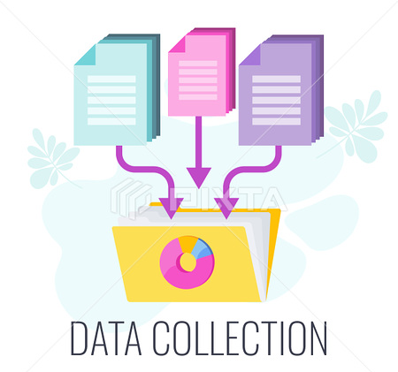
Introduction:
The term "data" refers to a collection of facts, figures, objects, symbols, and events obtained from many sources. Data is collected by businesses in order to make better judgments. Data is acquired at various moments in time from various audiences since it is difficult for businesses to make effective decisions without it.

Slide 4
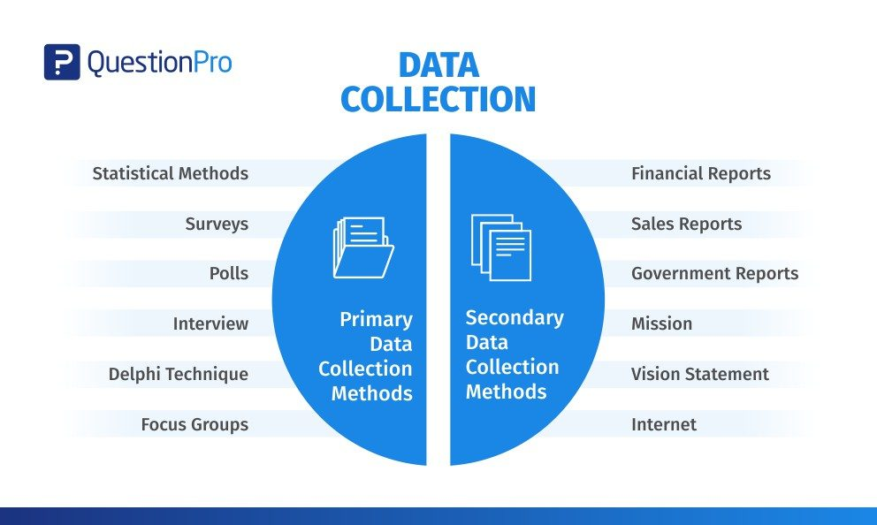
Two Types Of Data Collection :

Slide 5
Primary Data Collection:

Slide 6

Qualitative Vs Quantitative Data Collection Methods
Some of the methods discussed here are quantitative, meaning they deal with quantifiable data. Others are qualitative, which means they take into account more than just numerical values. In general, quantitative methods such as questionnaires, surveys, and documents and records are used, whereas qualitative methods such as interviews, focus groups, observations, and oral histories are used. There may be some overlap between the two approaches.

Slide 7
Secondary Data
External Sources Of Secondary Data
Internal Sources Of Secondary Data

Slide 8

Internal Sources Of Secondary Data:
Organization’s health and safety records
Mission and vision statements
Financial Statements
Magazines
Sales Report
CRM Software
Executive summaries

Slide 9
External Sources Of Secondary Data:
Government reports
Press releases
Business journals
Libraries
Internet

Slide 10
Conclusion:
Data collection refers to putting your data collection plan into action. You've selected how you'll get data - whether it'll be by direct observation, interviews, surveys, experimentation and testing, or other means.

Slide 11
References:
Data Collection Methods: Definition, Examples and Sources. QuestionPro. (2021, March 31). https://www.questionpro.com/blog/data-collection-methods/.
Ainsworth, Q. (n.d.). Data Collection Methods. JotForm. https://www.jotform.com/data-collection-methods/.

Slide 12
Thanks

