Slide 1


Libyan International Medical University Faculty Of Business Administration
Several Selection Methods For Hiring Employees
Name : nahawand elhammai
ID : 2752
Email : nahawand_2572@limu.edu.ly

Slide 2
Table Of Contact :
1.Introduction
2.The Different Types Of Selection Methods
3.Which methods are suitable for a particular job?
4.8 Steps In The Selection Process For Hiring
5.Conclusion
6.
6.References

Slide 3
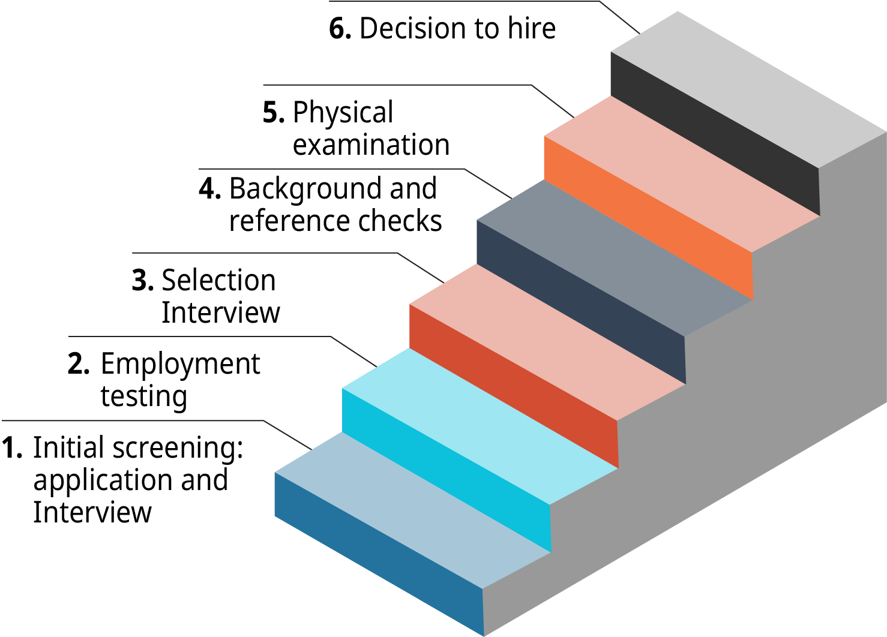
Introduction
(Figure) outlines the steps in the employee selection process. For each stage of the hiring process, determining offers a suite of pre-employment exams, and selection entails treating job applicants as valued consumers.

Slide 4
The Different Types Of Selection Methods
2

Slide 5

Curriculum vitae :a CV is a document that applicants complete and submit alongside a job application.
Application form :an application form is completed by a potential employee when they apply for a job.
Letter of application.
Interviews.
Tests.
Group activities.
References.

Slide 6
Which Methods Are Suitable For A Particular Job?
3

Slide 7

When deciding which approach to use, it's important to think about the job's needs, which can be found in the job description and person specification, as well as the talents, experience, and aptitudes that are desired. Some organizations specify how they will evaluate that need during the selection process in the person specification. so that potential applicants are informed of the processes that will be used by the organization Of course, for a given job, more than one selection approach may be appropriate.
To ensure that the selection procedure is effective, it is also necessary to assess its success. This can be accomplished by soliciting feedback from candidates who have gone through the selection process or examining recruiting data and turnover rates. It's also a good idea to go over the selection processes that were employed the last time the job was open and make sure they're still relevant and effective in the current selection process, especially if the job has changed or new talents are required.

Slide 8
8 Steps In The Selection Process For Hiring
4

Slide 9

Here Are Eight Steps In The Selection Process For Hiring Employees And How To Best Go Through Each:
1.Application.
2.Resume Screening.
3.Screening Call.
4.Assessment Test.
5.In-person Interviewing.
6.Background Checks.
7.Reference Checks.
8.Decision And Job Offer.

Slide 10
Conclusion:
To select employees, you must examine their abilities and talents and if they are suitable for the job or not.

Slide 11
References:
team, C. (2021, March 31). 8 steps in the selection process for hiring [A complete guide]: Workable. Recruiting Resources: How to Recruit and Hire Better. https://resources.workable.com/tutorial/employee-selection-process#.
BBC. (n.d.). Methods of selection - Recruitment in business - OCR - GCSE Business Revision - OCR - BBC Bitesize. BBC News. https://www.bbc.co.uk/bitesize/guides/zm98kmn/revision/4.
Selection Methods for Graduate Talent. GRB. (n.d.). https://www.grb.uk.com/recruiter-research/selection-methods.

Slide 12

Thank You

