Slide 1


Outline the Features of the Balance Scorecard Approach
Libyan International Medical University
Faculty of Business Administration
Name : Nahawand Elhammali
ID :2752
Email: nahawand_2752@limu.edu.ly

Slide 2
Table Of Content:
01
02
03
04
Introduction
The Features Of Balanced Scorecard
The 7 Steps To Success
Conclusion

Slide 3
Introduction:
The balanced scorecard (BSC) may be a strategic planning and management System, Organizations use (BSCs) to: Adjust the day-to-day work that everybody is doing with technique. Prioritize projects, items, and administrations. Measure and screen advance towards strategic targets.

Slide 4
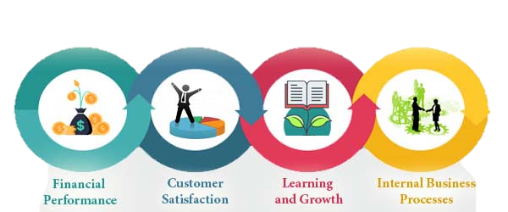
What are the features of balanced scorecard?
The four measurements of performance that are considered in a balanced scorecard are:
01
02
03
04
Financial.
Customer.
Internal process.
Learning and growth.

Slide 5
What Are The 7 Steps To Success?

Slide 6
The 7 Steps To Success:
Step 1:
Assessment.
Step 4:
Performance Measures.
Step 2:
Strategy.
Step 5:
Strategic Initiatives.
Step 3:
Strategy Mapping.
Step 6:
Performance Analysis.
Step 7:
Evaluation.

Slide 7
Conclusion:
Balanced scorecard useful because the balanced scorecard gives a effective system for building and communicating technique. The business model is pictured in a methodology outline which makes a difference directors to think almost cause-and-effect connections between the distinctive vital destinations.

Slide 8
Reference:
Balancedscorecard. (2020, February 5). Nine Steps to Success. Balanced Scorecard Institute. https://balancedscorecard.org/about/nine-steps/.
Graybeal, P., Franklin, M., & Cooper, D. (2018, July 24). Describe the Balanced Scorecard and Explain How It Is Used. Principles of Accounting Volume 2 Managerial Accounting. https://opentextbc.ca/principlesofaccountingv2openstax/chapter/describe-the-balanced-scorecard-and-explain-how-it-is-used/.

Slide 9
Thank You

