Slide 1


Understanding the Meaning of Management by: Adam Mohammed student number: 2734 e-mail address: adam_2734@limo.edu.ly
Libyan International Medical University
Faculty of Business Administration

Slide 2
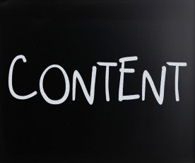

Slide 3

What Is Management ?

Slide 4
.
    Management is the process of dealing with or controlling things or people.
    Management refers to the process of governing and controlling the activities of the organization , to develop a business environment where the employees can work cooperatively and achieve the business objectives.

Slide 5
Five M’s of management
1. Methods
2. Material
3. Machinery
4. Money
5. Man power

Slide 6

Nature of management

Slide 7
1. Management is a combination of art and science.
2. Management is a multi-disciplinary-discipline.
3. Management is intangible.
4. Management is pervasive at all levels.
5. It is an environment oriented. (we can not work as an individual system without interacting with the environment)
6. Management uses the resources in the best possible way.

Slide 8
The Importance of Management

Slide 9
1. For the effective usage of resources.
2. Development of resources.
3. For better coordination.
4. Provides security to employees.
5. To complete the work within a time frame.

Slide 10
Conclusion

Slide 11
Management is the process of planning , organizing , directing , and controlling activities of and using recourses of an organization for achieving the organizational goals effectively and efficiently in an ever changing environment.

Slide 12
REFERENCES
Easy MBA (2018, April, 16). “Definition, concept, and importance of management” : http://youtube.be/0GyKxRYx1tQ - YouTube.
Key differences (2020, JAN, 14). “ What are the functions of management? Meaning and description” : http://youtube.be/qZphA3Xg- YouTube.

Slide 13


