Slide 1


Business Market
Libyan International Medical University
Faculty of Business Administration
Name: Ameen Bendardaf
ID: 2769
Email: ameen_2769@limu.edu.ly

Slide 2
Table of Contents
01
02
03
04
Introduction
What is business market?
Conclusion
Reference
2

Slide 3
01
introduction
3

Slide 4
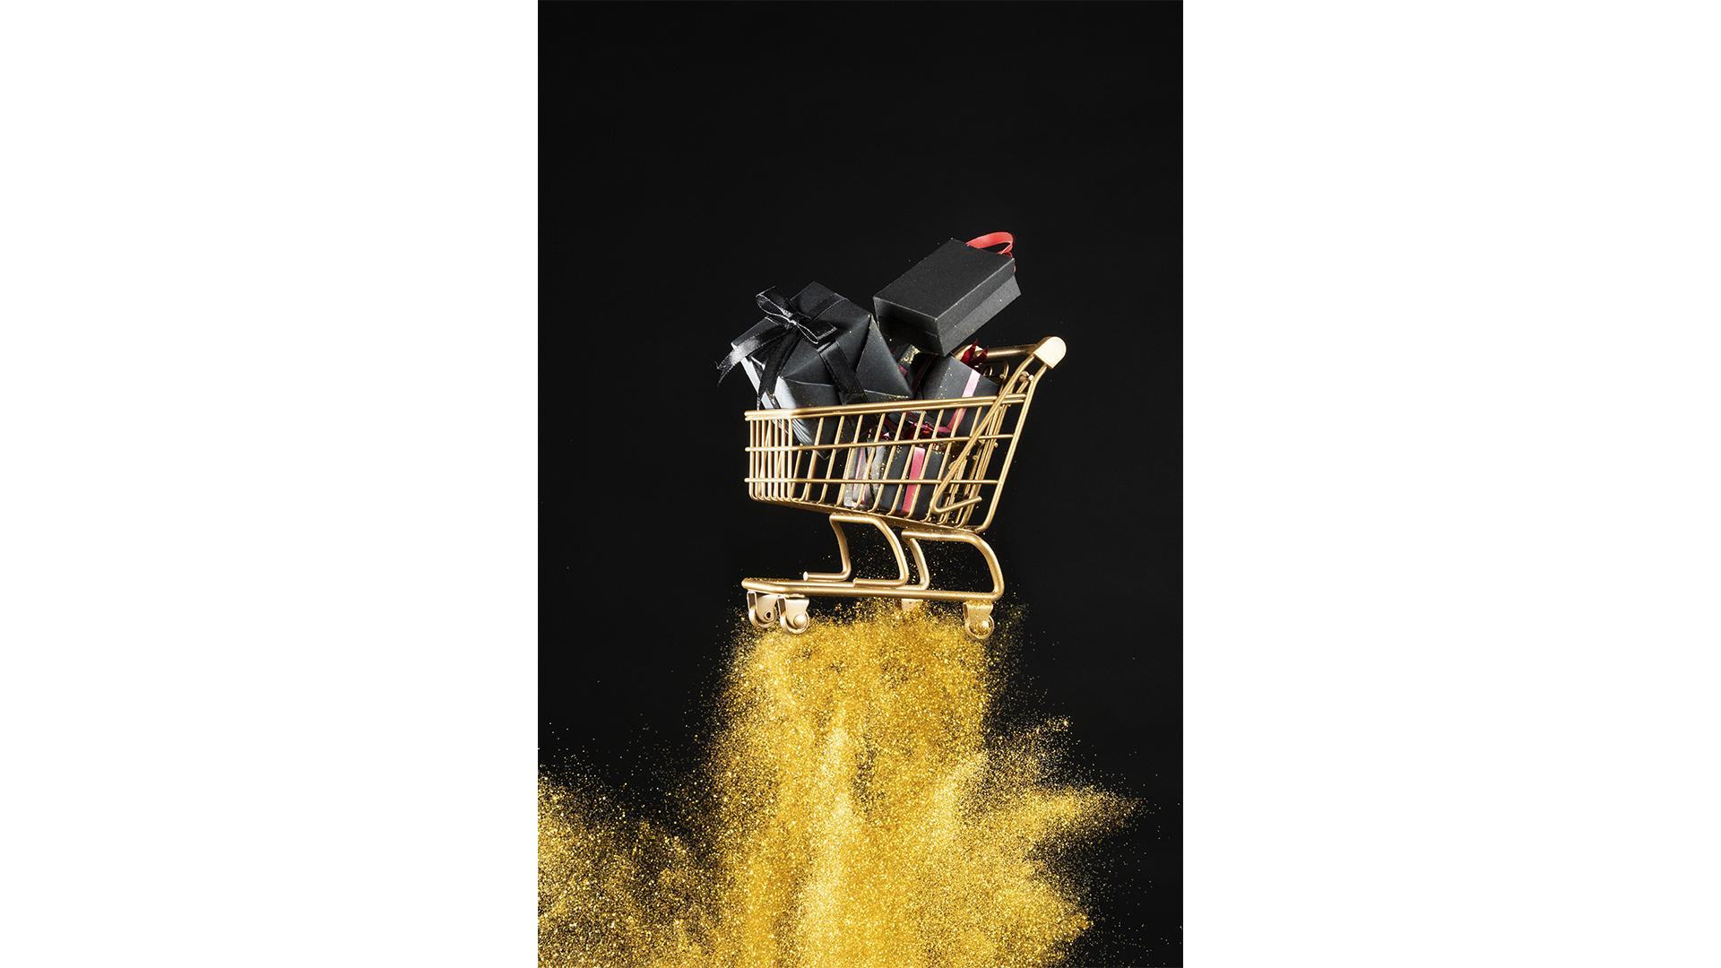
Introduction
The business market is the process of selling your product and services to other businesses, where those products and services will either be used as a raw material for the manufacturing of other products. Or those businesses buy the products or services and resell them.
4

Slide 5
02
What is Business Market?
5

Slide 6

Business Market
A business market is a method a company uses to sell products or services to a specific group of consumers.
Business markets facilitate sales from one business to another in cases where one business plans to reuse or resell another company's products or services.
6

Slide 7

Continues
A company that purchases goods and services in a business market might also use the items they purchase as materials to produce new products of their own.
7

Slide 8
03
Conclusion
8

Slide 9
Business market is how business works.
Many ways to do business. needs a clear brain to be successful.
9

Slide 10
04
Refrence
10

Slide 11
Team, I. (n.d.). Business markets: Definition, types and examples. Retrieved April 28, 2021, from https://www.indeed.com/career-advice/career-development/business-market
11

Slide 12
Thank You!
12

