Slide 1


Major Types of Buying- Decision Making
Libyan International Medical University
Faculty of Business Administration
Ghadi Dreza
2830
ghudai_2830@limu.edu.ly
20th April 2021

Slide 2
01
03
What is Consumer Behaviour?
What are the four types of consumer buyer behaviour?
02
04
References
Conclusion
Content
1

Slide 3
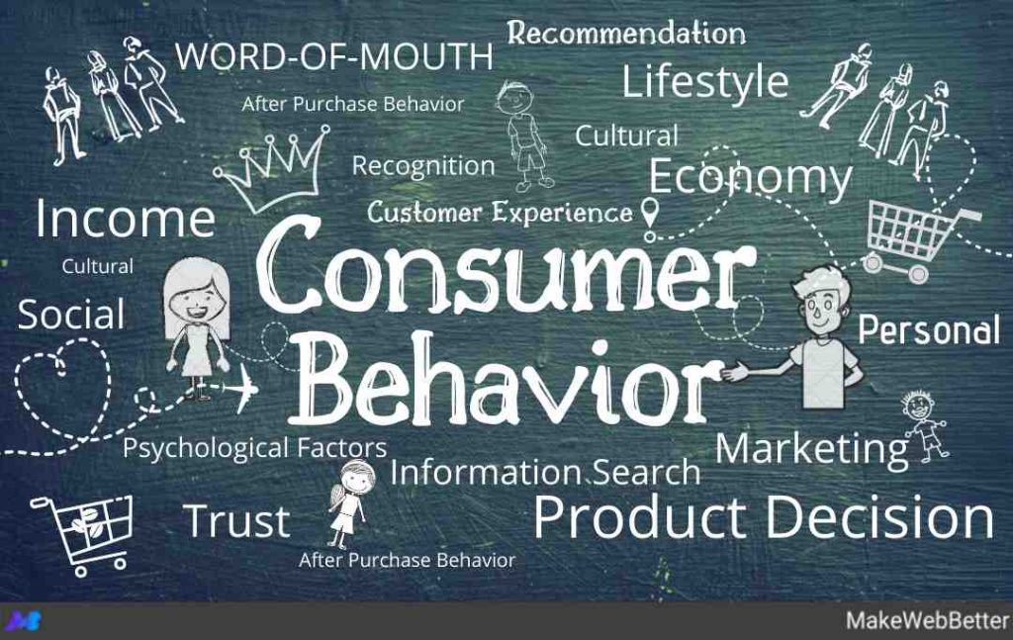
Introduction
Consumer Behaviour is the study of how consumers are driven to buy and use a product.
2

Slide 4
Why is Consumer Behaviour Importany?
3

Slide 5
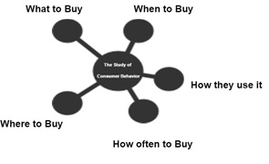
To market you first have to understand how people choose to perceive the product provided by the organization. Thus, this process involves the consumer with a lot of complex analysis thinking.
4

Slide 6
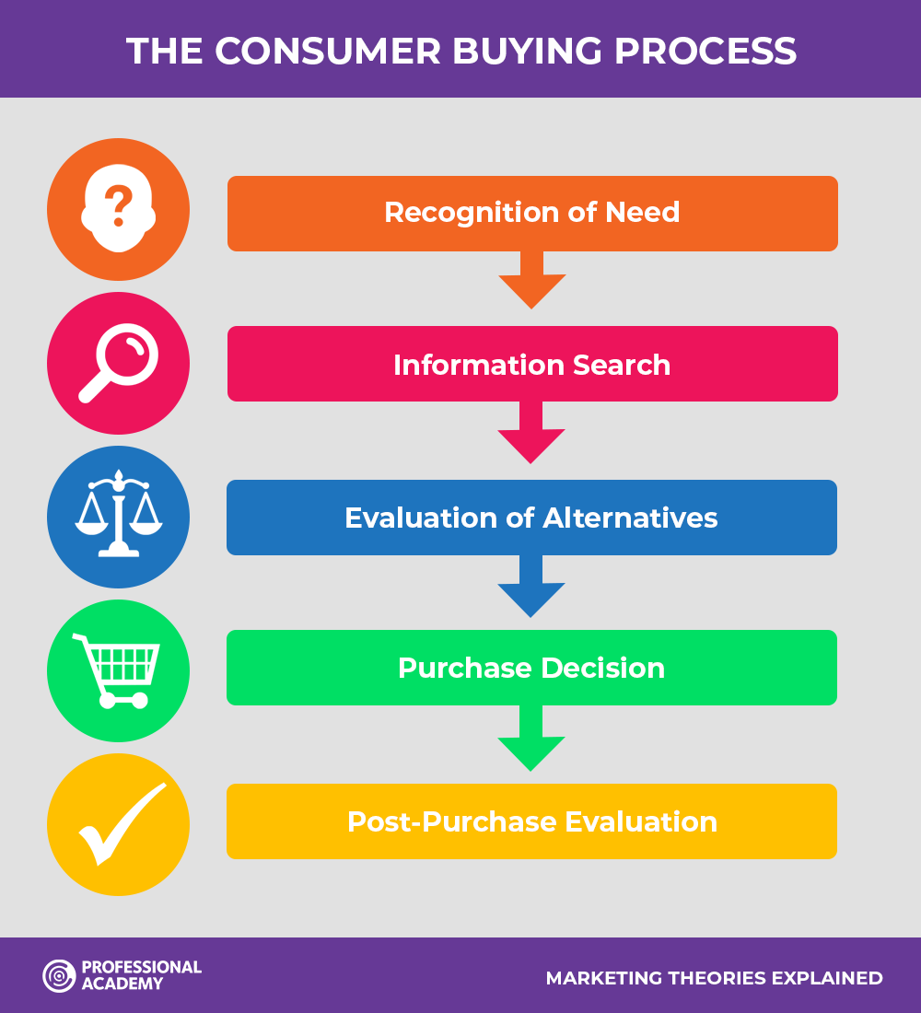

Slide 7
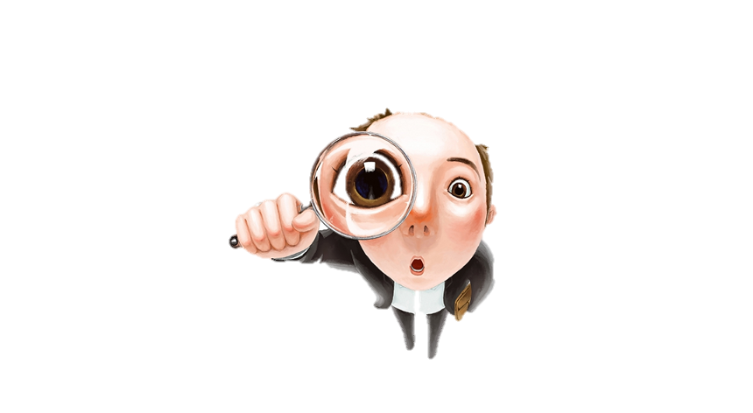
Major Types of Consumer Buying Behaviour:
Complex buying behaviour
Variety seeking buying behaviour
Dissonance-reducing buying behaviour
Habitual buying behaviour
Consumers are highly involved in the purchasing decision. There thoughts and decisions may vary when buying a car to buying a coffee.
The desire to change products, because of their lack satisfaction with the current one.
This is were a buyer would purchase a product and shortly after they feel the guilt.
This involves low rates of decision making when it comes to buying routine based products.
5

Slide 8
Conclusion
1
2
3
Understand your costumers.
Listen to your costumers.
Deliver the right products to the right group of people.
6

Slide 9
References
Lister, J. (2017, November 21). What is dissonance in marketing? Retrieved April 21, 2021, from https://smallbusiness.chron.com/dissonance-marketing-25900.html
Why consumer behaviour is so important in marketing. (2018, July 25). Retrieved April 21, 2021, from https://www.techfunnel.com/martech/why-consumer-behavior-is-so-important-in-marketing/
What are the 4 types of customer buying behavior? (2021, April 06). Retrieved April 21, 2021, from https://clootrack.com/knowledge_base/types-of-consumer-behavior/
7

Slide 10


