Slide 1


Process and Elements Driving Globalization
Libyan International Medical University
Faculty of Business Administration
Ameen Bendardaf
2769
ameen_2769@limu.edu.ly

Slide 2
Table of Contents
01
Introduction
02
What is Globalization?
03
Elements of Globalization
04
Conclusion
2

Slide 3
01
Introduction
3

Slide 4
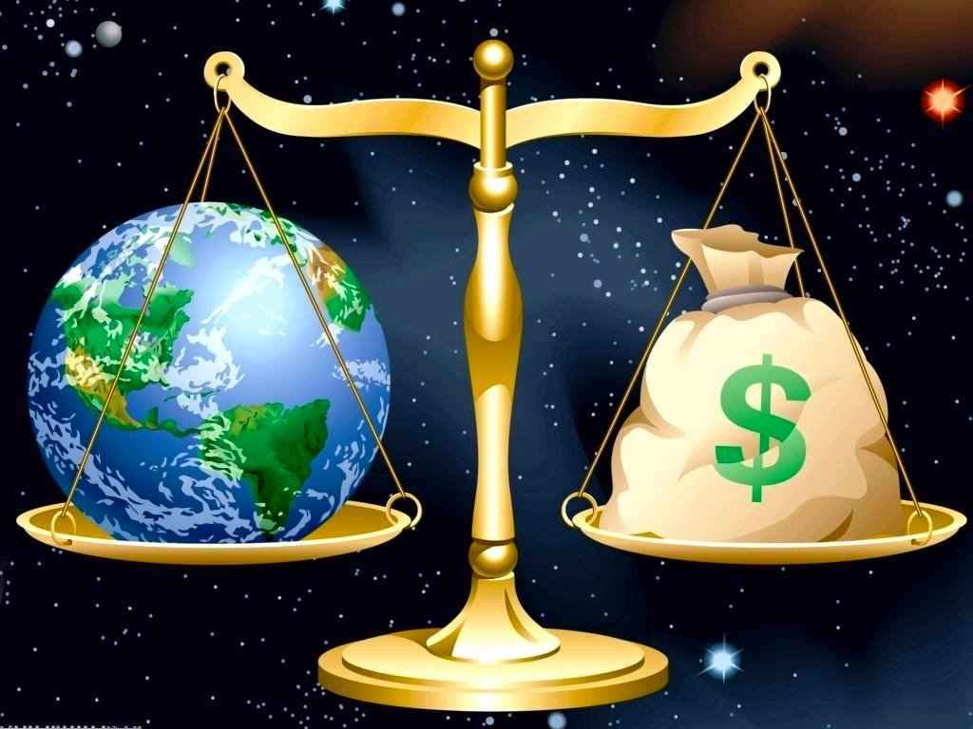
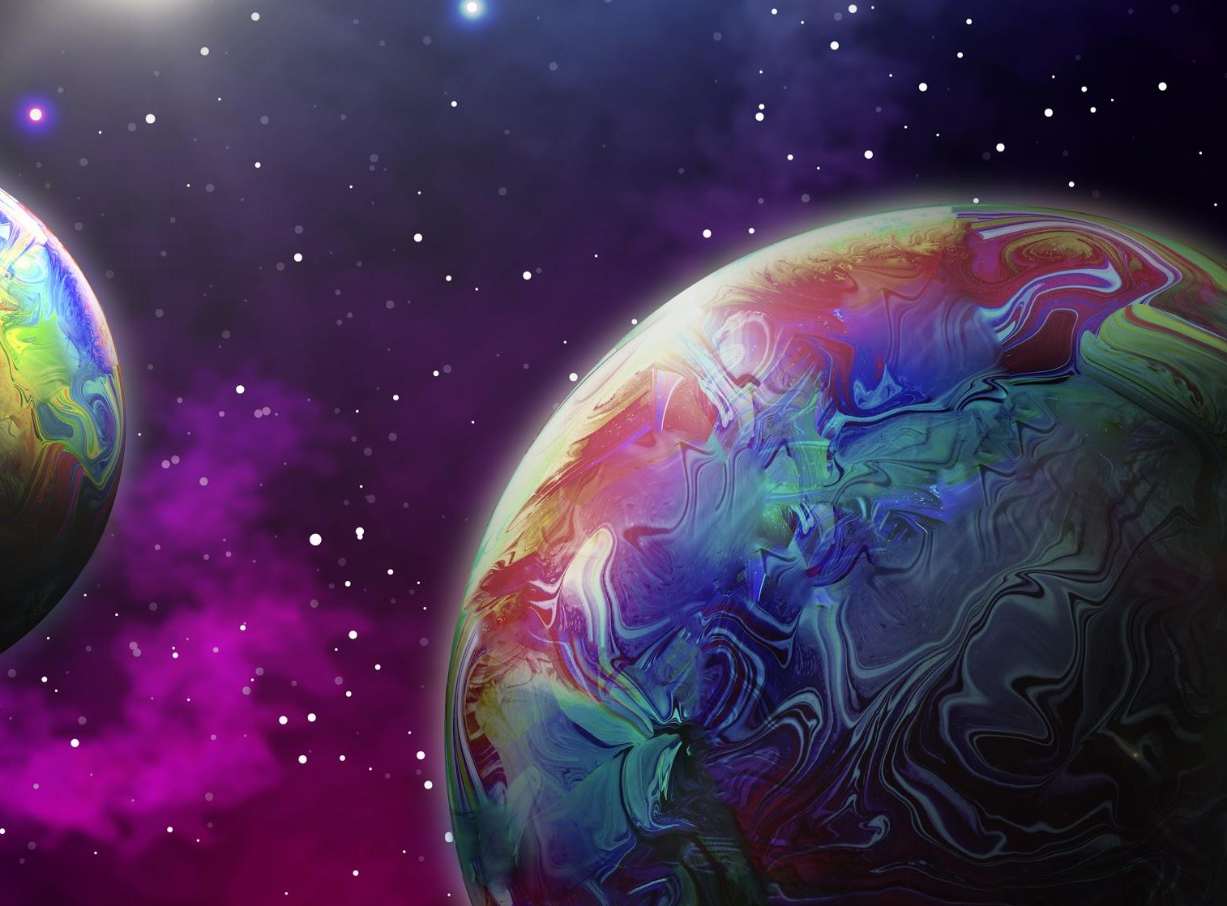
Economic Globalization
How the world make money?
4

Slide 5
02
What is Globalization?
5

Slide 6
The increasing interdependence of world economies as a result of the growing scale of cross-border trade of commodities and services, the flow of international capital and the wide and rapid spread of technologies.
6

Slide 7
03
Elements of Globalization
7

Slide 8
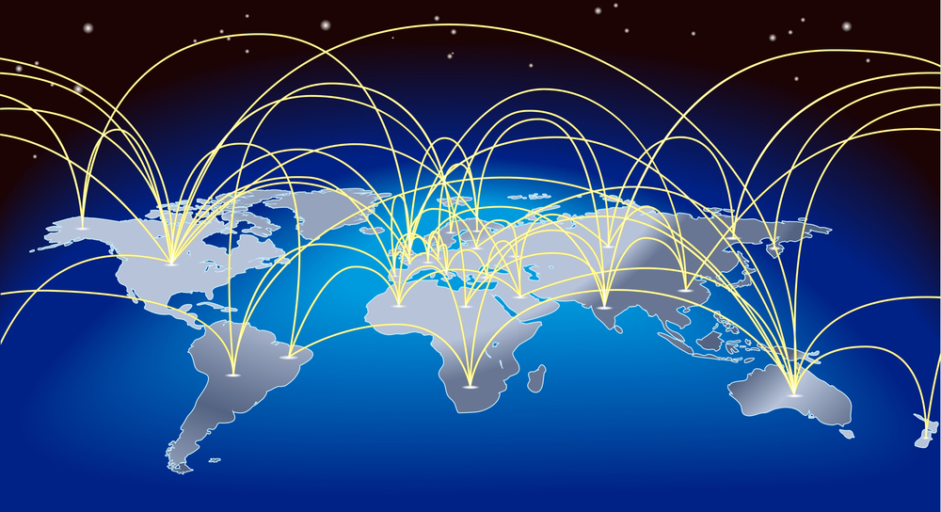
International Trade
An increasing share of spending on goods and services is devoted to imports and an increasing share of what countries produce is sold as exports.
8

Slide 9
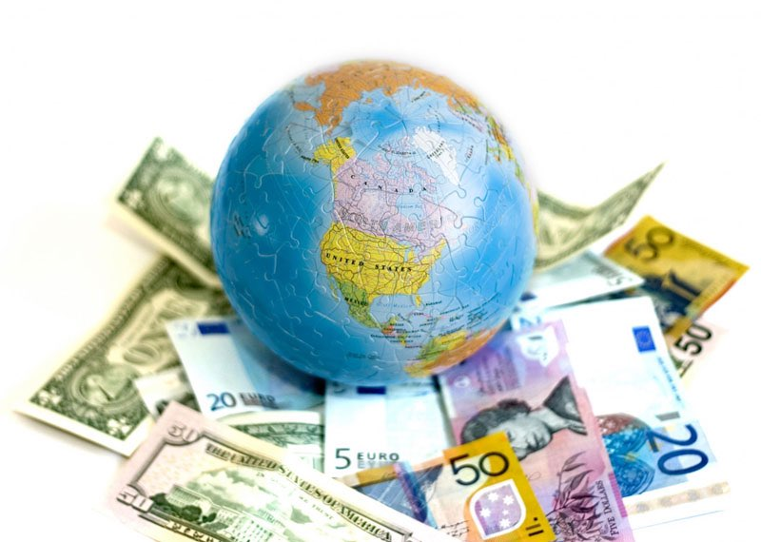
Foreign Direct Investment
Investment made to acquire lasting interest in enterprises operating outside of the economy of the investor
9

Slide 10
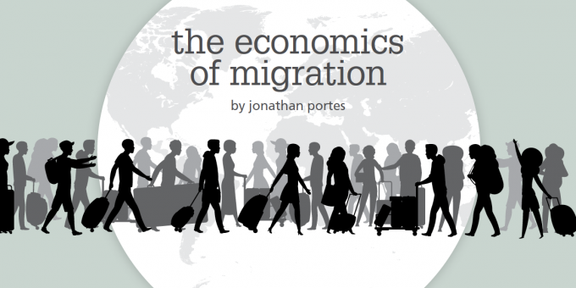
Migration
Migration can benefit developing economies when migrants who acquired education and know-how abroad return home to establish new enterprises. However, migration can also hurt the economy through “brain drain”, the loss of skilled workers who are essential for economic growth
10

Slide 11
04
Conclusion
11

Slide 12
Globalization is how people around the world make money.
12

Slide 13
References
Lennon, J. (2020, October 06). What is globalization? Examples, definition, benefits and effects. Retrieved April 21, 2021, from https://youmatter.world/en/definition/definitions-globalization-definition-benefits-effects-examples/
Mariadoss, B. (n.d.). Core principles of international marketing. Retrieved April 21, 2021, from https://opentext.wsu.edu/cpim/chapter/1-7-what-is-globalization/
13

Slide 14
Thank You!
14

