Slide 1


Explaining the Hallmarks of Scientific Research
Libyan International Medical University
Faculty of Business Administration
Name: Abdullah Zwawi
ID: 2826
Email: abdullah_2826@limu.edu.ly

Slide 2
Contents
Introduction
The 8 Hallmarks of Scientific Research
Conclusion
Reference

Slide 3
Introduction
Scientific research is defined by the strategy of understanding how everything works through logical thinking.

Slide 4
The 8 Hallmarks of Scientific Research
Purposiveness
Rigor
Testability
Replicability
Precision and confidence
Objectivity
Generalizability
Parsimony

Slide 5
Purposiveness
Research should have a definite aim or purpose.

Slide 6
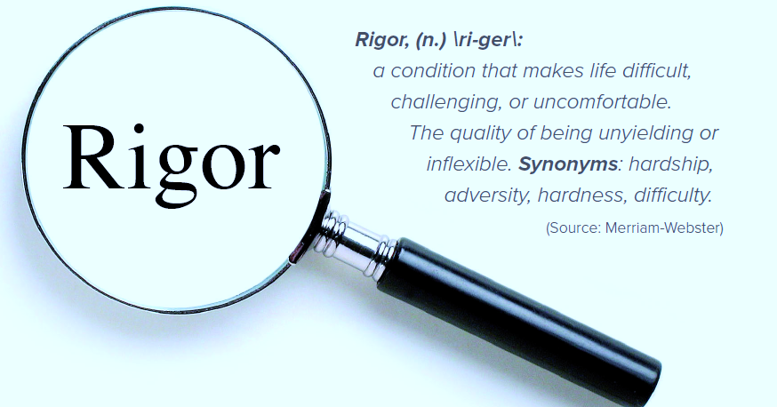
Rigor
Rigor indicates carefulness and degree of exactitude in research.

Slide 7

Testability
Scientific research lend itself to testing logically developed hypothesis to see whether or not data support the educated conjecture or hypothesis.

Slide 8

Replicability
The results of the test of hypothesis should be supported again and again

Slide 9
Precision and Confidence
Precision reflects the degree of exactness and accuracy of the results on the basis of samples.
Confidence refers to the probability that our estimation are correct so that we can confidently claim that 95% of the time our results will be true and there is only 5% chance of our results being false.

Slide 10
Objectivity
The conclusion drawn through the interpretation of the results of data analysis should be objective not on our own subjective or emotional values .

Slide 11
Generalizability
It refers to the scope of replicability of the research findings in one organizational settings to others, the wider the range of replicability of the solution generated by the research the more useful the research is to the user.

Slide 12
Parsimony
Simplicity in explaining the phenomenon or problem that occur in generating the solutions of the problem is preferred as compared to complex research frame work.

Slide 13
Conclusion
In conclusion the 8 hallmarks scientific research complete each other.
Scientific research follows scientific methods and tools to explain its variable.

Slide 14
Reference
muazzam. “Hallmarks of Scientific Research.” Business Education, 29 Mar. 2009, bizedu.wordpress.com/2009/03/29/hallmarks-of-scientific-research/. Accessed 5 Apr. 2012.

Slide 15
Thank you !

