Slide 1


Identify the Major Components of an Organization Task Environment
Libyan International Medical University
Faculty of Business Administration
Ghadi Dreza
ghudai_2830@limu.edu.ly
2830
5th April 2021

Slide 2
Table of Contents
Definition of External Environments:
Definition of Task Environment:
Major Components of a Task Environment:
Conclusion &
References
2

Slide 3
01
Definition of External Environments:
3

Slide 4

External Environment may consist of outside factors that affect the ability of the company to reach its given destination.
4

Slide 5
02
Definition of Task Environment:
5

Slide 6
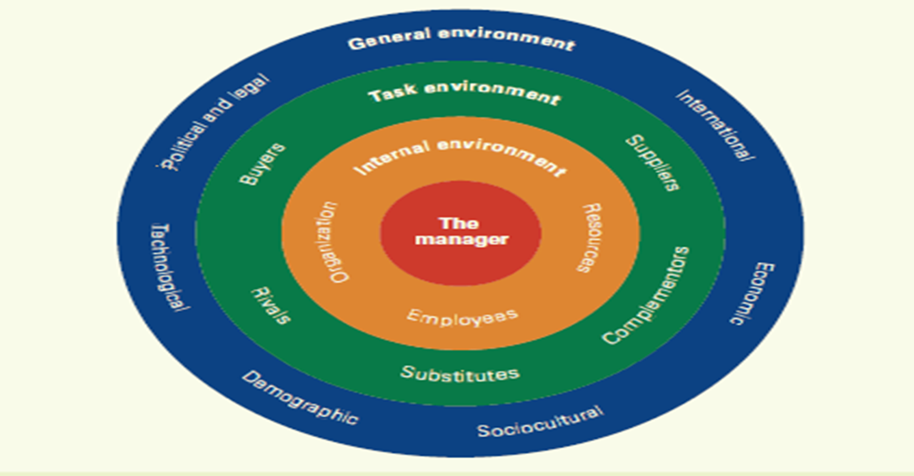
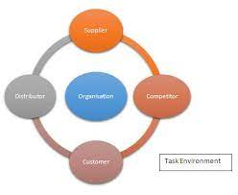
Task environments are specific external groups that act as factors affecting the firm.
6

Slide 7
03
Major Components of a Task Environment:
7

Slide 8
Major Components of a Task Environment:
Competitors
Costumers & Suppliers
Other companies may offer better products to the same costumers
Suppliers are the product creators and the costumers are the demand (source of income to the company)
Government Regulations
Labour Market
War, Currency inflation:
These are major political factors that affect all business big and small… but it depends whether the benefit is good or bad.
For a business to operate, there most be a flow of employees; this is “labour marketing.”
8

Slide 9
Conclusion
To conclude, as the External Environment factors; Task environment plays a major role in the process of analysing what happens in the bigger world and to how far are you able to protect your company?
9

Slide 10
References
Take online Courses. earn college Credit. research schools, DEGREES & careers. (n.d.). Retrieved April 06, 2021, from https://study.com/academy/lesson/task-environment-definition-components.html
Gumati, T. (2020, April 9). Portal of Libyan international: Lecture 2 the External & Internal Environments. Retrieved April 06, 2021, from http://portal.limu.edu.ly/mod/resource/view.php?id=24096
10

Slide 11



