Slide 1



Identify The Changes In The Marketing World
Libyan International Medical University
Faculty of Business Administration
Ghadi Dreza
2830
ghudai_2830@limu.edu.
5th April 2021

Slide 2
01.
02.
03.
04.
What is marketing as a concept?
How did the marketing world change?
References
Conclusion
Table of contents

Slide 3

01.
What is marketing as a concept?

Slide 4

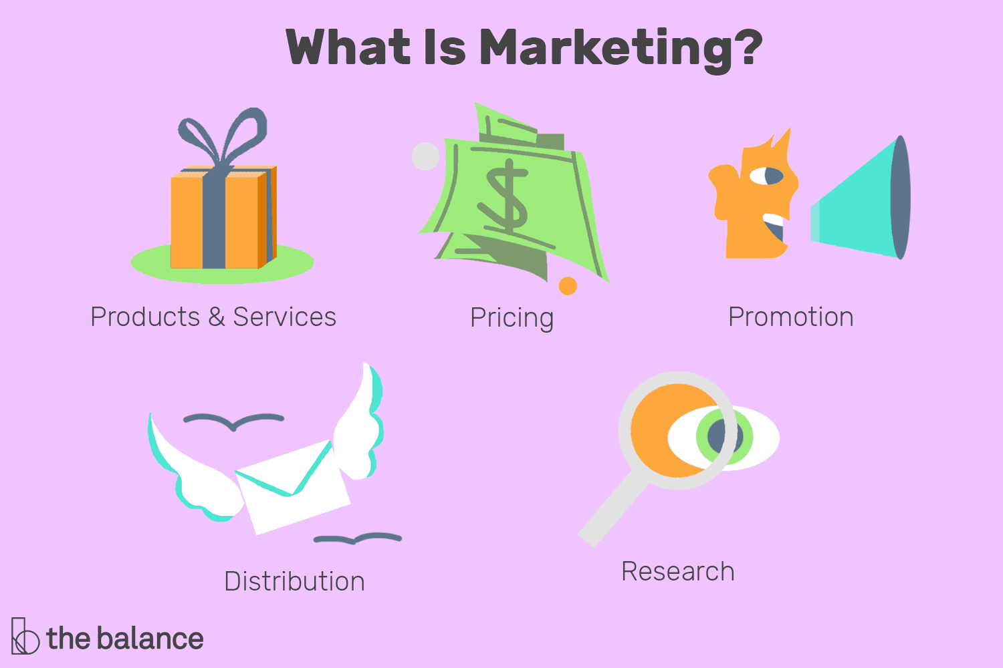
Marketing refers to the idea of an organization attempting to promote and sell products.

Slide 5
02.
How did the marketing world change?

Slide 6

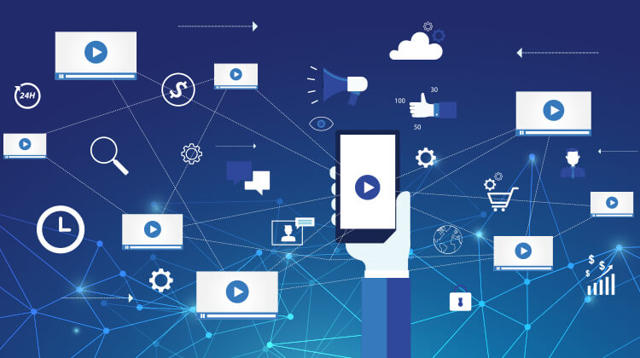
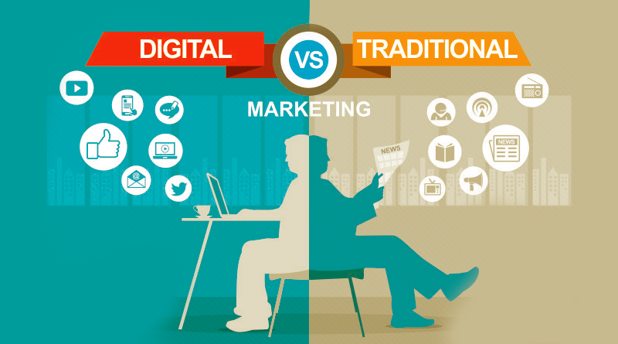
Marketing over the past 10 years has undergone a massive transformation; the use of technology has had an impact on individuals day to day lives, and therefore it paved the way for digital marketing to blossom.

Slide 7
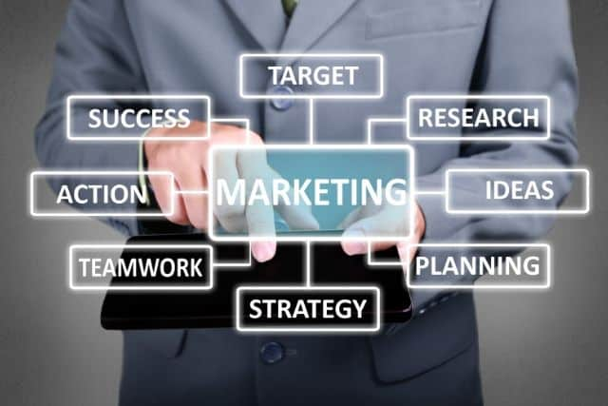
Social Media Marketing
Content Marketing
The Different Types of Marketing
Influencer Marketing
Affiliate Marketing
It’s the process of using social media e.g. Instagram, Facebook, Whatapp, Twitter for the means of selling products to the consumers.
It’s the process whereby you consistently produce, distribute, and promote relevant online materials.
It’s the process of working with highly followed individuals to promote a certain product or service to the people whom follow them.
The process of a business working with an individual influencer to promote other business products.

Slide 8
Traditional Marketing? How was it used?

Slide 9
Traditional Marketing refers to the process of selling products, services, and more via the traditional ways e.g. newspapers, direct mail.

Slide 10
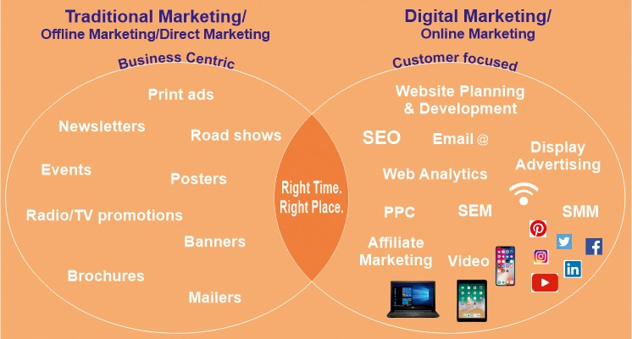

Slide 11
“100% of costumers are people.
100% of employees are people.
If you don’t understand people you don’t understand business.”
Conclusion

Slide 12
Resources
Law, T. (2021, February 26). The beginner's guide to 7 types of internet marketing. Retrieved April 06, 2021, from https://www.oberlo.com/blog/beginners-guide-7-types-internet-marketing
Louth, J. (2018, February 05). The changing face of marketing. Retrieved April 06, 2021, from https://www.mckinsey.com/business-functions/marketing-and-sales/our-insights/the-changing-face-of-marketing

Slide 13


