Slide 1


Obstacles To Be Conducting Scientific Research
Libyan International Medical University
Faculty of Business Administration
Name :Ameen Bendardaf
ID: 2769
Email : ameen_2769@limu.edu.ly

Slide 2
Table of contents
01.
02.
03.
04.
Introduction
Discussing the 3 major obstacles
Conclusion
Reference
2

Slide 3
01.
Introduction
3

Slide 4
A scientific problem is something you don't understand but you can do an experiment to help you understand. Scientific problems are usually based on observation of scientific phenomena.
4

Slide 5
02.
The 3 Major Obstacles
5

Slide 6

1-Financial crunch in academia
Researchers face perpetual struggle to secure and sustain funding.
While the scientific workforce is increasing. The situation is particularly perilous for early career researchers who find it hard to compete for funds with senior researchers.
6

Slide 7

2. Poor study design in published papers
One of the primary reasons behind this problem is that statistical flaws in published research often go undetected.
Since breakthrough results are valued the most, researchers feel compelled to hype their results in order to get published.
They tend to focus on particular patterns in data and manipulate their study designs to make the results more attractive for the journals.
7

Slide 8
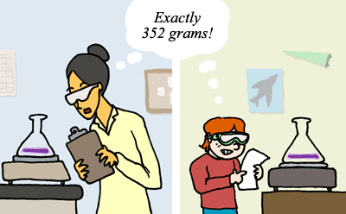
3-lack of replication studies
It is very important that research can be replicated, because it means that other researchers can test the findings of the research.
Replicability keeps researchers honest and can give readers confidence in research. ... If the research is replicable, then any false conclusions can eventually be shown to be wrong.
8

Slide 9
03.
Conclusion
9

Slide 10
Research need financial assistance.
Time and patience for good paper design for the journals.
Replication studies to know that your going in the right path
10

Slide 11
04.
Reference
11

Slide 12
Kulkarni, S. (2021, February 18). 7 major problems science is facing: A Survey overview. Retrieved April 06, 2021, from https://www.editage.com/insights/7-major-problems-science-is-facing-a-survey-overview?refer=scroll-to-1-article&amp;refer-type=article
12

Slide 13
Thank You!
13

