Slide 1

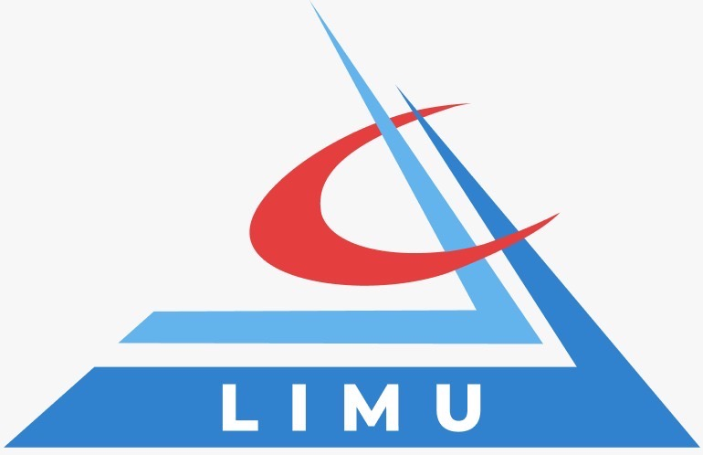

The Main Functions of Management
Libyan International Medical University
Faculty of Business Administration
Name: OMAR KHALED
Student ID: 2770
Email: omar_2770@limu.edu.ly

Slide 2
01
introduction
02
List the main functions of management
03
Explain the functions
TABLE OF CONTENTS
04
Importance of management
05
Conclusion
06
Reference
2

Slide 3

Introduction
Managers can have a broader and more complex set of responsibilities than other positions and departments within the business. More than just specialized knowledge, management requires an ability to navigate challenges in the process of guiding one's team to the completion of various goals.

Slide 4
Organizing
Planning
The functions of management
leading
Controlling
4

Slide 5
01
Planning
5

Slide 6
Planning
Allocating employee resources and delegating responsibilities.
Continuously check on team progress in order to make small adjustments when necessary.
Setting priority levels for certain tasks.
Creating timelines.
Communication.
6

Slide 7
02
Organizing
7

Slide 8
ORGANIZING
A manager's organizational skills can help to ensure a company or departmental unit runs smoothly.
Establishing internal processes and structures.
Knowing which employees or teams are best suited for specific tasks.
Keeping everyone and everything organized throughout daily operations.
8

Slide 9
03
leading
9

Slide 10
LEADING
Managers should be comfortable and confident commanding their team members’ daily tasks.
Projecting a strong sense of direction and leadership when setting goals and communicating new processes.
Recognizing when employees need an extra boost of reinforcement.
Praise to handling conflicts between team members fairly and decisively.
Managers may function as leaders even during small personal interactions by modeling supportive, encouraging, and motivational qualities.
10

Slide 11

04
Controlling
11

Slide 12
CONTROLLING
Managers should consistently monitor employee performance, quality of work, and the efficiency and reliability of completed projects.
Control in management is about making sure the ultimate goals of the business are being adequately met, as well as making any necessary changes when they aren't.
12

Slide 13
Why is Management Important ?
Strong managers create empowerment, removing roadblocks for teammates, supporting career growth, and sharing a compelling vision for each teammate for how their work fits in to the bigger picture.
13

Slide 14
Conclusion
In conclusion, a good manager that have a connection with the employees and have the ability to lead and control them right, will mostly have a successful business and a well organized company.
14

Slide 15
Reference
American InterContinental University, C. (2020, October 22). The four functions of Management: What managers need to know. Retrieved March 31, 2021, from https://www.aiuniv.edu/degrees/business/articles/functions-of-management#:~:text=Originally%20identified%20by%20Henri%20Fayol,each%20may%20look%20in%20action.
15

Slide 16
Thank you!
Any questions?
16

