Slide 1


Explain: The Exchange Process Mechanism
Libyan International Medical University
Faculty of Business Administration
Name: Ghadi Dreza
ID:2830
ghudai_2830@limu.edu.ly
27th March 2021

Slide 2
Table of Contents
01
02
03
04
05
06
What Is The Exchange Process?
What are the five conditions of exchange?
Examples of exchange in marketing.
What is exchange and relationship in marketing?
References
Conclusion
2

Slide 3
01
What Is The Exchange Process?
You can enter a subtitle here if you need it
3

Slide 4
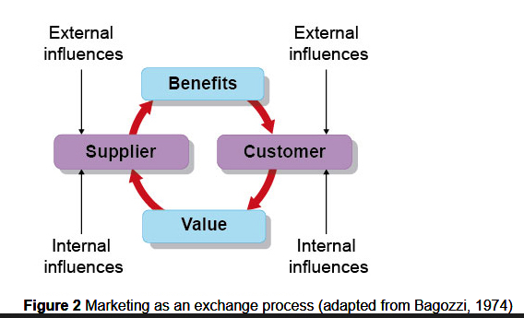
Exchange Process happens when an individual or an organisation satisfies the needs of costumers by offering them goods or services.
4

Slide 5
02
What are The Five Conditions Of Market Exchange?
You can enter a subtitle here if you need it
5

Slide 6



What are the Five Conditions Of Market Exchange?
There Must be two parties involved.
Each party has to have something of value to the other party.
Capable of communicational and delivery processes
Each party is entitled to accept or reject the proposal.
Each party is capable of providing needed products to other parties as well.
6

Slide 7
03
What are Some Examples Of Market Exchange?
You can enter a subtitle here if you need it
7

Slide 8
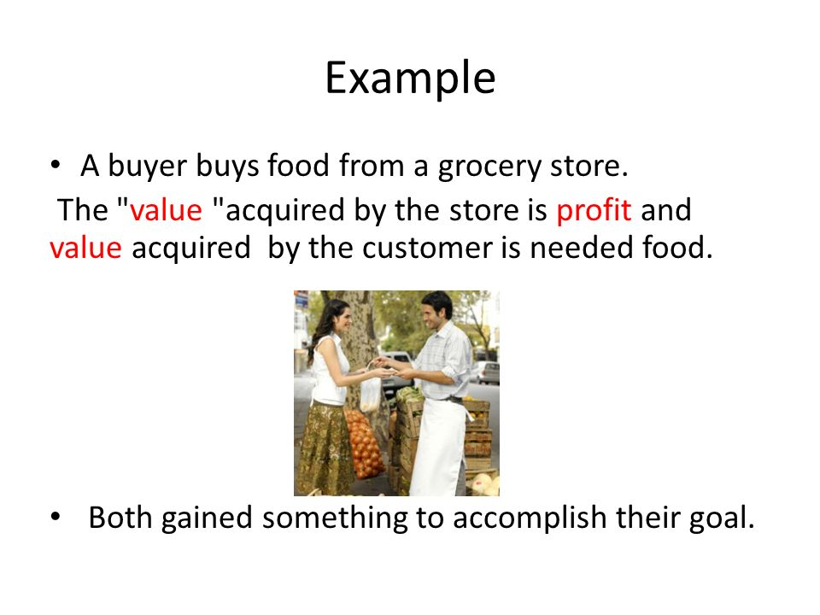
8

Slide 9
04
What is exchange and relationship in marketing?
9

Slide 10


Relationship- Marketing- Exchange is an on international level scale were the service providers would convert their one-time buyers into long-term costumers.
An example of RME is keeping in contact with your costumers… almost as if you are spoiling them with gift cards for their continued support to the company or brand etc.
10

Slide 11

Conclusion
Exchange Process marketing is a simple way of making an decent exchange of a certain value to the right party.
11

Slide 12
References
Marketing Concepts/Exchange. (n.d.). Retrieved March 30, 2021, from https://brainmass.com/business/cost-minimization-strategies/marketing-concepts-exchange-198067
Friesner, T. (2016, April 28). Marketing exchange process. Retrieved March 30, 2021, from http://www.marketingteacher.com/marketing-exchange-process/
Kokemuller, N. (2017, November 21). How should an exchange relationship marketing strategy work? Retrieved March 30, 2021, from https://yourbusiness.azcentral.com/should-exchange-relationship-marketing-strategy-work-29098.html
12

Slide 13

Thank You!
13

