Slide 1
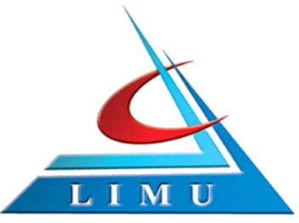


Libyan International Medical University
Faculty of Business Administration
The Major Bases for Segmenting Markets
Name:Yakoub Elwerfalli
ID:3194
Faculty of Business Administration|
DATE:18\5\2021
Yakoub_3194@limu.edu.ly

Slide 2
CONTENTES
1. what is market segmentation.
2.What are the types of market
. segmentations
3.what is the importance of market
segmentation.

Slide 3
What is market segmentation
Is a marketing strategy in which select groups of consumers are identified so that certian product or products lines can be presented to them.

Slide 4
Types of market segmentations
. 1.Demographic segmentation
. 2.grographic segmentation
. 3. benefits sought segmentation

Slide 5
Importance of market segmentations
Market segmentation can help to define and better understand your target audiences and ideal customers.

Slide 6
conclusion
Market segmentation is a marketing concept which divides the complete market set up into smaller subsets comprising of consumers with a similar taste, demand and preference.
A market segment is a small unit within a large market comprising of like minded individuals.

Slide 7
refernences
Gitman, L. J., McDaniel, C., Shah, A., Reece, M., Koffel, L., Talsma, B., & Hyatt, J. C. (2018, September 18). Market Segmentation. Introduction to Business. https://opentextbc.ca/businessopenstax/chapter/market-segmentation/.

Slide 8
THANK YOU

