Slide 1



Understand the Marketplace and Customer Needs
Libyan International Medical University
Faculty of Business Administration
Name: Nada Elsaiti
Email: naday_3063
ID: 3063
6/4/2021

Slide 2
Table Of Content
2
1
2
3
4
What is marketplace and customer needs
The marketplace and customer needs
Conclusion
References

Slide 3

What are a marketplace needs
3
It is a marketing concept that relates to the functional or emotional needs or desires of a target market.

Slide 4
The marketplace needs
4

Slide 5

1- Target marketing
5
One of the first steps in marketing is to look at the target audience for your products or services and to identify one or more market segments.

Slide 6

2- Functional or Emotional needs
6
Needs are generally categorized as either functional or emotional.

Slide 7

3- Differentiated Marketing
7
Differentiation is a key component of effective marketing, especially in highly competitive industries.

Slide 8

What are a customer needs
8
A customer needs are the things that customers require when purchasing a product or service.

Slide 9
The customer needs
9

Slide 10
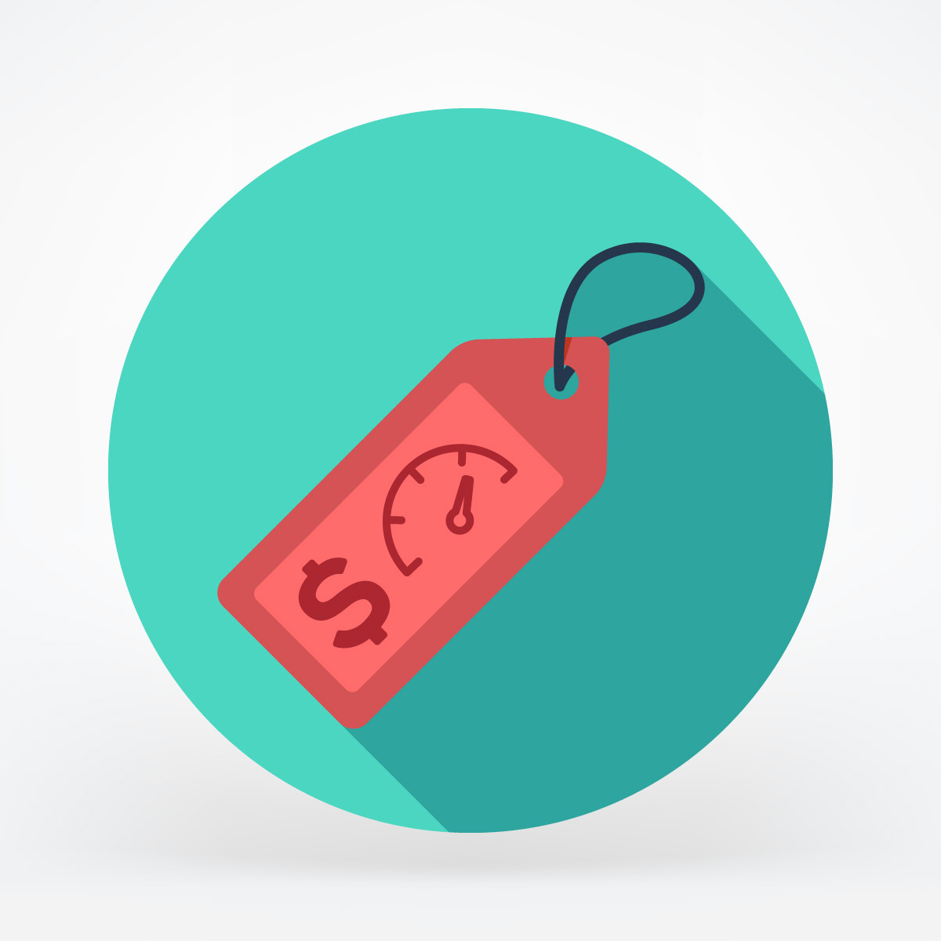
1- Price
10
Price is how much a business charges for its product or service.

Slide 11
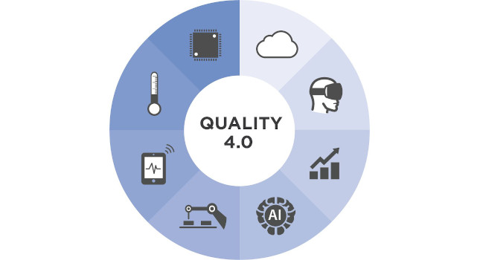
2- Quality
11
Quality relates to the standard of the product or service being offered.

Slide 12

3- Choice
12
Choice is very important, many businesses have a range of products and/or services available to suit different groups of customers.

Slide 13
Conclusion
13
Once the marketers fully understand the marketplace and customers, they can design a marketing strategy to find, attract, keep and grow target customers.

Slide 14
Kokemuller, N. (2017, November 21). What Does “Marketplace Needs” Mean? Small Business - Chron.Com. https://smallbusiness.chron.com/marketplace-needs-mean-74802.html
Stobierski, T. (2020, September 1). 3 Most Common Types of Customer Needs to Be Aware Of | HBS Online. Business Insights - Blog. https://online.hbs.edu/blog/post/types-of-customer-needs
Reference

Slide 15
Thank You!!! :)

