Slide 1


The Uses of PC Software
Libyan International Medical University
Faculty of Business Administration
  By: Mahmod Fathi Gargom
  Mahmoud＿2859@limu.edu.ly
  2859

Slide 2
Content
Introduction
Business software
The importance of computers in our daily lives
Conclusion
Questions
Reference

Slide 3
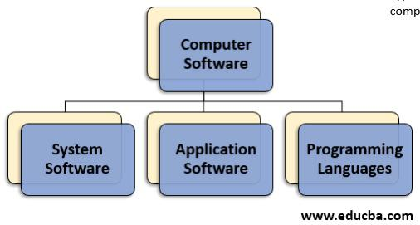
Introduction
The definition of software
· It’s the instructions that tell a computer what to do
· A set of instructions that directs a computer’s hardware to perform a task is called a program, or software program.
· The three main types of software are system software ，application software and programing languages

Slide 4
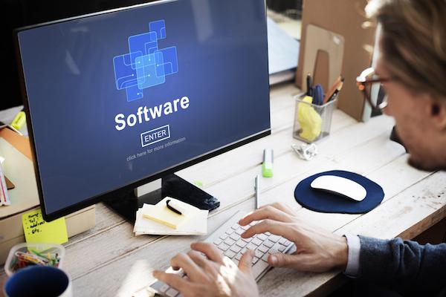
Business software
Business software is a type of application software
Most business processes now involve the use of computers.
Here are some of them: _ communications , research , media production , product development
An example of business software is a computer program designed to allow a restaurant to take orders on a computer.

Slide 5
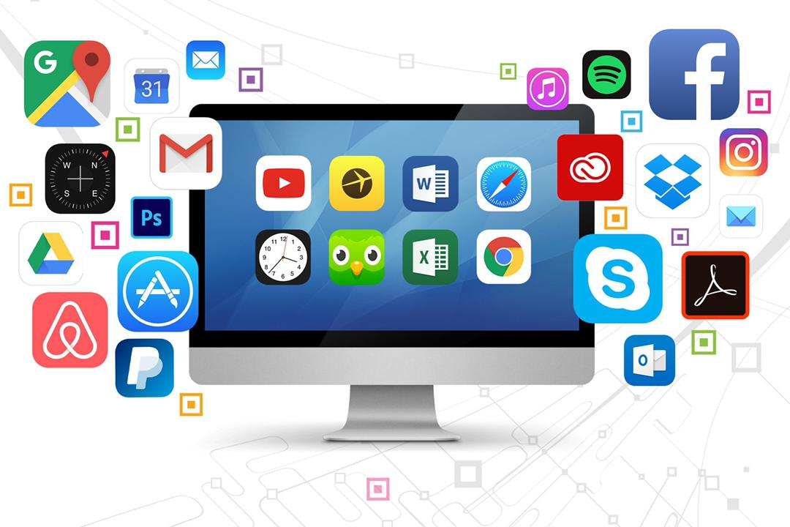
The Importance of Computers in Our Daily Lives
In this day and age there are numerous amounts of software each designed to have a purpose. Software can be found or used on just about any industry in the world, from entertainment and healthcare to education and sales.
computer software is used to solve problems, find cures, or just play games. Software is used in every industry.

Slide 6
Conclusion
Softwares used in almost everywhere in the world . its use is increasing day by day because it saves time ,effort ,money .it gives a huge output from a small input.

Slide 7
Questions
What is the main types of pc software ?
Enumerate Some of the uses of pc software?

Slide 8
Reference
https://www.quora.com/What-are-the-uses-of-computer-software
https://smallbusiness.chron.com/importance-computers-business-4012.html
https://www.yourdictionary.com/business-software
https://www.britannica.com/technology/software

Slide 9
Thank you for listening

