Slide 1


Libyan International Medical University
Faculty of Business Administration
  Literature Review Development
  By: Mahmod Fathi Gargom
  Mahmoud＿2859.@limu.edu.ly
  2859

Slide 2
Content
Introduction
What is a literature review?
Why write a literature review?
Steps to writing a Iiterature review
Conclusion
Questions
Reference

Slide 3
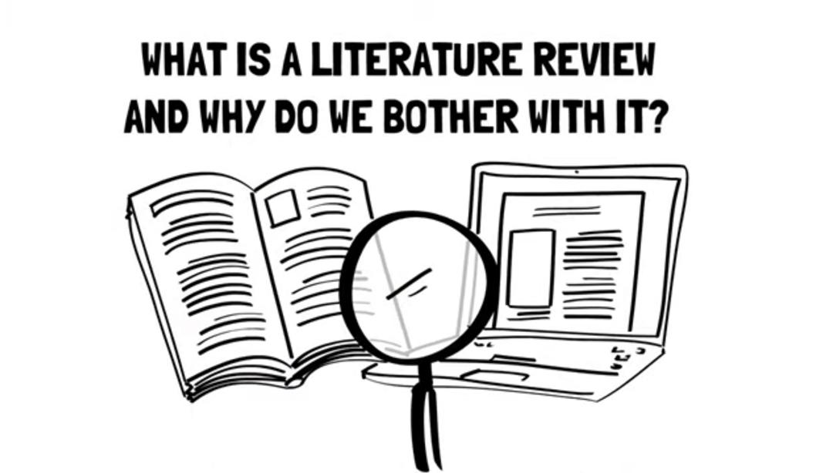
Introduction

Slide 4
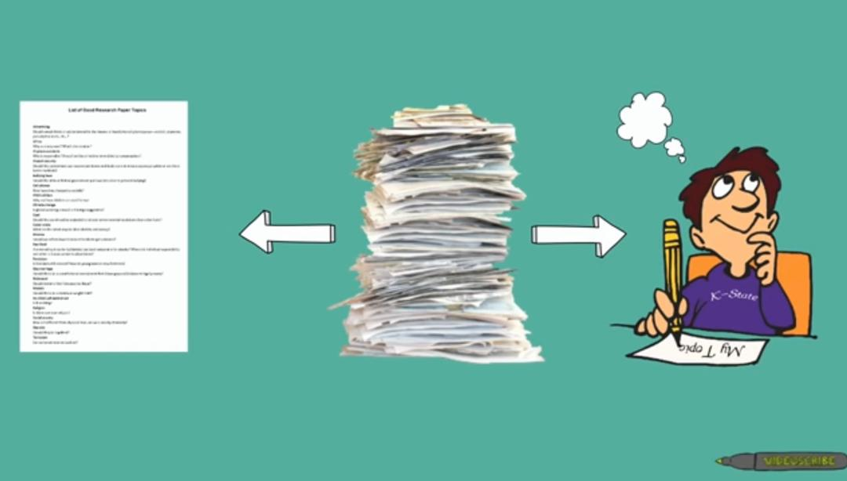
What is a literature review?
Definition : A survey of what has already been researched on a specific topic.It could be anything from books , journal articles or other sources.

Slide 5
Why write a literature review?
It provides an overview of current knowledge, allowing you to identify relevant theories, methods, and gaps in the existing research.

Slide 6
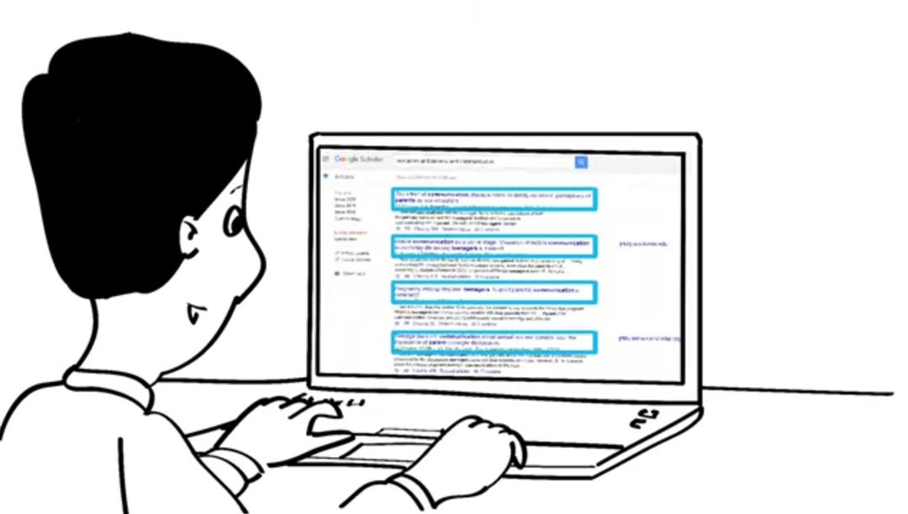
Steps to writing a Iiterature review
There are six main steps in the process of writing a literature review:
Step1: Search for relevant literature
choose a focus and develop a central question to direct your search
creating a list of keywords related to your research topic that you’re interested in

Slide 7
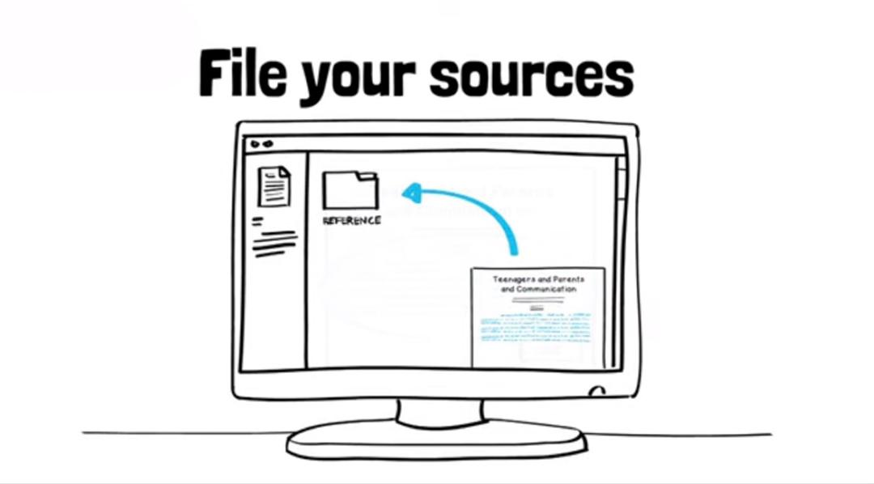
Step 2: Evaluate and select sources
You probably won’t be able to read absolutely everything that has been written on the topic – you’ll have to evaluate which sources are most relevant to your questions.See What are the results and conclusions of the study Take notes and cite your sources It’s important to keep track of your sources with references

Slide 8
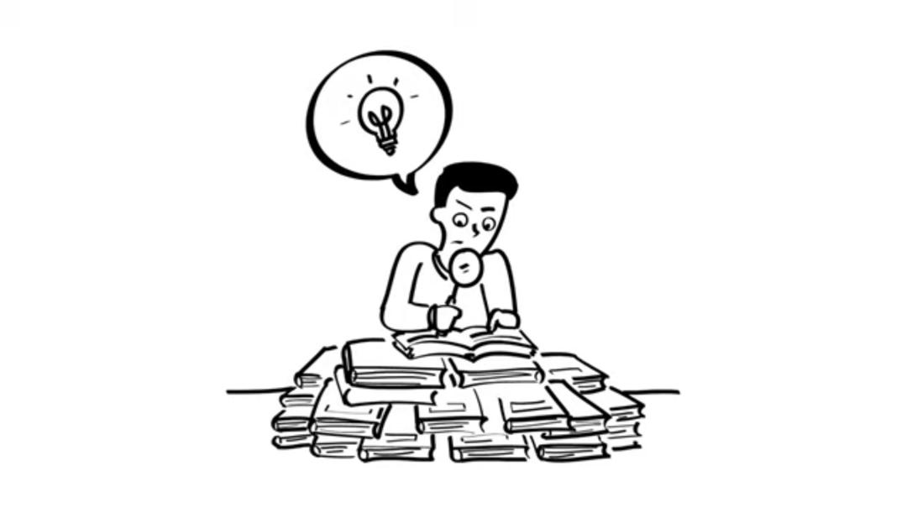
Step 3: Identify themes, debates and gaps
Themes: what questions or concepts recur across the literature?
Debates: where do sources disagree?
Gaps: what is missing from the literature? Are there weaknesses

Slide 9
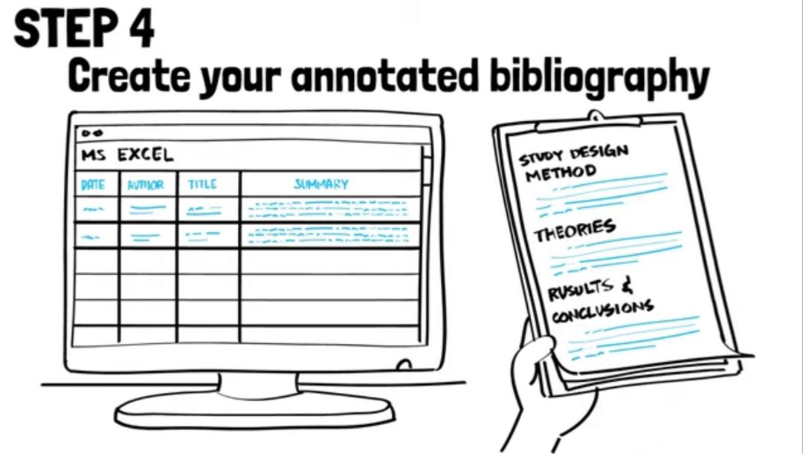
Step4: create your annotated bibliography By doing analysis of the publication

Slide 10
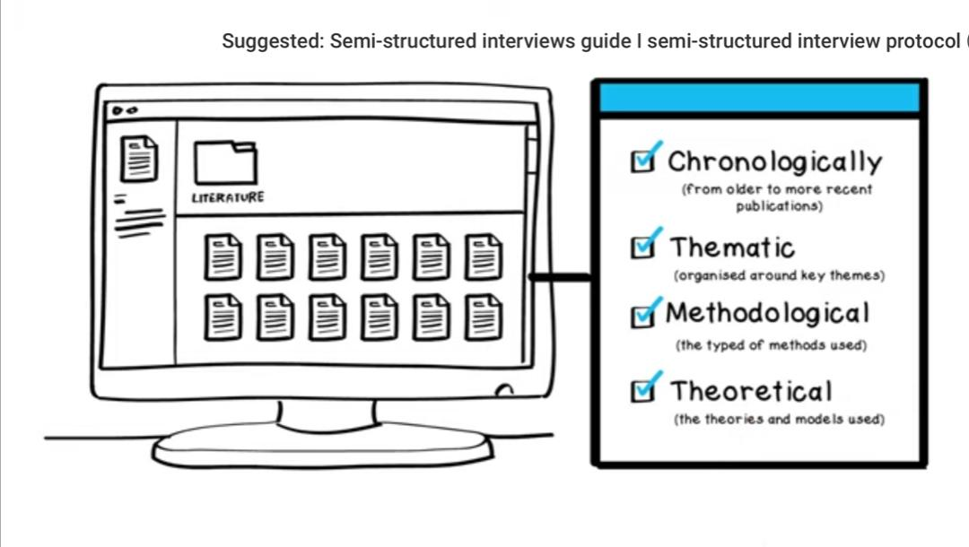
Step5: Outline the structure
organising the body of a literature review

Slide 11
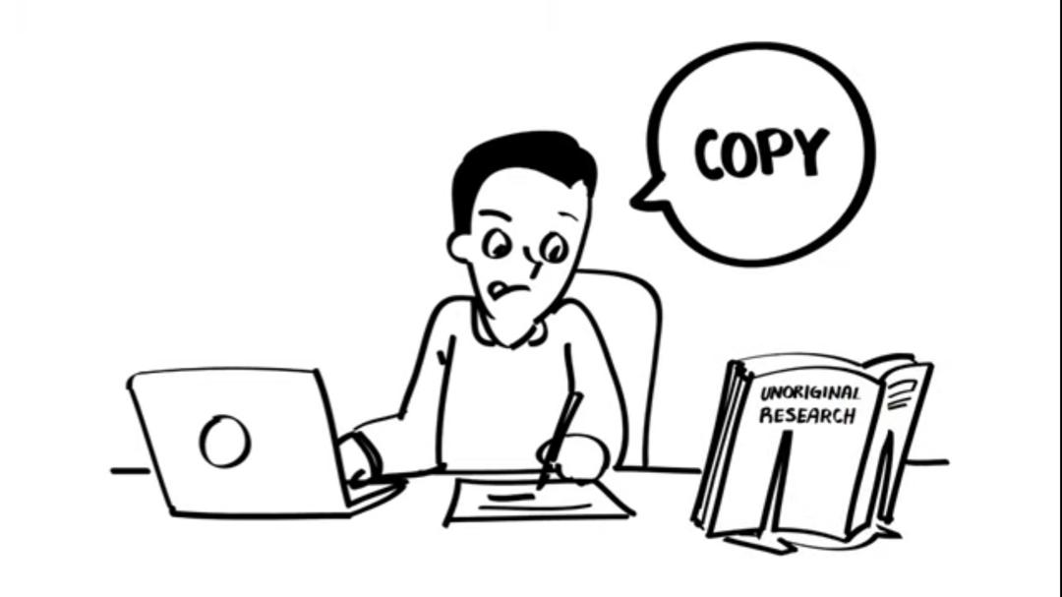
Step6: Write your literature review.
Like any other academic text, your literature review should have an introduction, a main body, and a conclusion.
You should write in a way that allows you not only to report, but also to compare, the review and comment on what has been said in the literature.

Slide 12
Conclusion
A good literature review doesn’t just summarise sources – it analyses, synthesises, and critically evaluates to give a clear picture of the state of knowledge on the subject.

Slide 13
Questions
What is a literature review?
What is the purpose of a literature review?

Slide 14
Reference
How to write a literature review fast i write a lit review fast! [Video file]. (2020, July 10). Retrieved April 20, 2021, from https://youtu.be/BgNehPgFiyc
McCombes, S. (Director). (2020, June 09). The literature review: A complete step-by-step guide [Video file]. Retrieved April 20, 2021, from https://www.scribbr.co.uk/thesis-dissertation/literature-review/
Academy, E. (n.d.). Literature review tips for the introduction and discussion sections. Retrieved April 20, 2021, from https://app.enago.com/homepage/i/19368/literature-review-tips-for-the-introduction-and-discussion-sections

Slide 15
Thank you for listening

