Slide 1


Consumer
Behaviour.
Libyan International Medical University
Faculty of Business Administration
JAVA
</>
UI
UX
Aisha Elshaare
2869
aisha_2869@limu.edu.ly
21st, Apr,2021

Slide 2
02.
TABLE OF CONTENTS
MAIN FACTORS:
01.
INTRODUCTION:
03.
cultural, social, personal, psychological.
CONCLUSION
04.
REFERENCE

Slide 3
INTRODUCTION
01.
Consumer purchases are heavily influenced by cultural, personal, social, and psychological characteristics. Marketers can not control such factors but can take them into consideration.
CSS

Slide 4
CULTURAL FACTOR:
Culture
Subculture
Social Class
</>
HTML
C++
CULTURE:
The set of basic values, perceptions, wants and behaviours learned by a member of society from family and other important institutions.

Slide 5

SUBCULTURE:
A group of people with shared value systems based on common life experiences and situations.
Nationalities
Religions
Racial groups
Geographic regions

Slide 6

SOCIAL CLASS
People/ groups with similar values, Behaviors, and interests.
Many factors determine social class. ( occupation, income, education, etc…)

Slide 7

SOCIAL FACTORS:
-Small groups and social networks
-Family
-Social roles and status

Slide 8
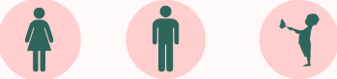
PERSONAL FACTORS:
-Occupation
-Age and Stage
-Economic Situation
-Lifestyle
-Personality and Self Concept

Slide 9

PSYCHOLOGICAL FACTORS:
-Motivation
-Perception
-Learning
-Beliefs and Attitudes

Slide 10
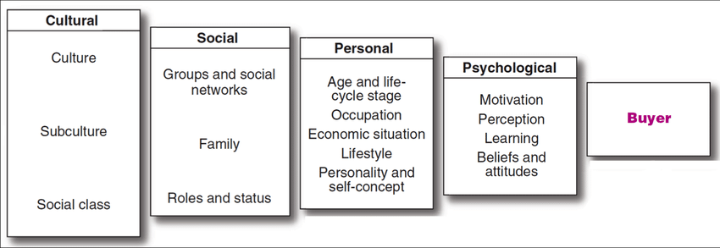
CONCLUSION:

Slide 11
REFERENCE:
Palmer, A. (2000). Principles of marketing. Oxford: Oxford University Press.

Slide 12
THANKS!
Do you have any questions?

Slide 13
QUESTION:
Mention the 4 factors that affect consumer behavior?

