Slide 1


Libyan International Medical University
Faculty Of Business Administration
Roles of Managers
Name : Khadija Mohammed Bayou
ID:2847
Email: Khadija_2847@limu.edu.ly

Slide 2
Content
Introduction.
Types of managers.
Managerial roles.
Conclusion.
References.

Slide 3
Introduction.
Who is the manager?
A manager is a person responsible for supervising and motivating employees and for directing the progress of an organization.

Slide 4
Types Of Managers.
General managers.
Functional mangers
Frontline managers

Slide 5
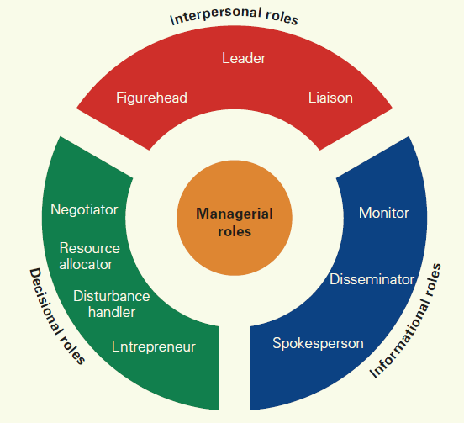
Definition Of Managerial Roles.
managerial roles : Specific behaviors associated with the task of management.

Slide 6
Interpersonal Roles
Interpersonal roles are roles that in volve interacting with other people inside and outside the organization.
Figureheads : Greet visitors, Represent the company at community events, Serve as spokespeople, and Function as emissaries for the organization
Leader : Influence, motivate, and direct others as well as strategize, plan, organize, control, and develop.
Liaison : Connect with people outside their immediate unit.

Slide 7
Informational Roles
////
Informational roles are concerned with collecting, processing, and disseminating information.
Monitors : managers scan the environment both inside and outside the organization
Spokesperson : managers deliver specific information to individuals and groups located outside their department or organization.
dissemination : managers regularly inform staff about the company’s direction and sometimes about specific technical issues.

Slide 8
Decisional Roles
Decisional Roles Deal With Actions.
Entrepreneur: Managers must make sure their organizations innovate, change, develop, and adopt
Disturbance handler: Addressing unanticipated problems as they arise and resolving them expeditiously
Resource allocator: How best to allocate scarce resources
Negotiator: Negotiation is continual for managers

Slide 9
Conclusion
managerial roles is a Specific behaviors associated with the task of management.
3 types of managerial roles:
Interpersonal Roles.
Informational Roles.
Decisional Roles.

Slide 10
References
Hill Charles, W.L. and McShane, S.L., 2008. Principles of management. New York.
Accountlearning.com
Contents for management studies

Slide 11


