Slide 1


Libyan international Medical university faculty of Business Administration
Out Line Internet Browsers and Websites
Name: Nhawnd Elhammali
Student ID :2752
Email:nahawand_2752@limu.edu.ly

Slide 2
TABLE OF CONTENT:
Definition internet ,browser ,website
What difference between internet, website and browser
Examples of browser and website
conclusion
Reference

Slide 3
1.Definition internet, browsers, websites

Slide 4
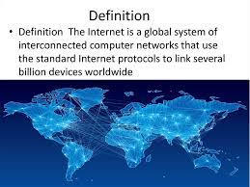
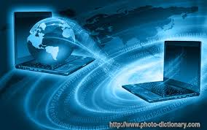
Internet definition:
Is the global system of interconnected computer networks that uses the internet protocol suits to communicate between networks and devices . It is a network of networks that consists of private ,public , academic ,business ,and government networks of local to global scope.

Slide 5
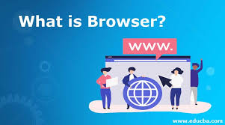
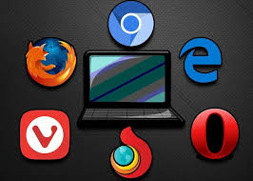
Browser definition:
is application software for accessing the world wide web. When a user requests a web page from a particular website ,the web browser retrieves the necessary content from a web server and then displays the page on the users device.

Slide 6
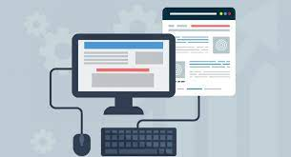
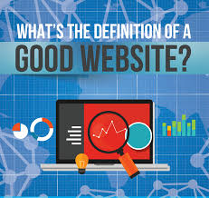
Website definition:
A group of world wide web pages usually containing hyperlinks to each other and made available online by an individual ,company ,educational institution ,government, or organization.

Slide 7
2.Difference between internet, website, browser

Slide 8
INTERNET
Linking your computer to other computers around the world is a way of transporting content
WEBSITE
The web is software that lets you use that content or contribute your own
BROWSER
Is software application used to access website it retrieves information web server

Slide 9
3.Examples of browser and website

Slide 10

5 Examples of browsers:
3 Examples of websites:
Internet explorer.
Firefox.
Google chrome.
Safari .
Microsoft .
Magazine websites.
Portfolio website.
Landing pages.

Slide 11
4.conclousion

Slide 12
Website and web browser are playing important improvement in business.
Also have their own place for the platform where there is specific information required.

Slide 13
reference
3 Dictionary by Merriam-Webster: America's most-trusted online dictionary. (n.d.). Retrieved April 12, 2021, from https://www.merriam-webster.com/
Internet. (2021, April 08). Retrieved April 12, 2021, from https://en.wikipedia.org/wiki/Internet
Computer history Museum. (n.d.). Retrieved April 12, 2021, from r
Computer history Museum. (n.d.). Retrieved April 12, 2021, from https://www.computerhistory.org/revolution/networking/19/314

Slide 14


