Slide 1


Libyan International Medical University
Faculty of Business Administration
Name: Sara Elzaidy
Student ID: 2758
Email: Sarah_2758@limu.edu.ly
Costumer Driven Strategy

Slide 2
TABLE OF CONTENT:
INTRODUCTION
WHAT IS CUSTOMER DRIVEN STRATEGY
THE TOP MAIN ELEMENTS OF CUSTOMER
CONCLUSION
CUSTOMER VALEU
REFRENCE

Slide 3
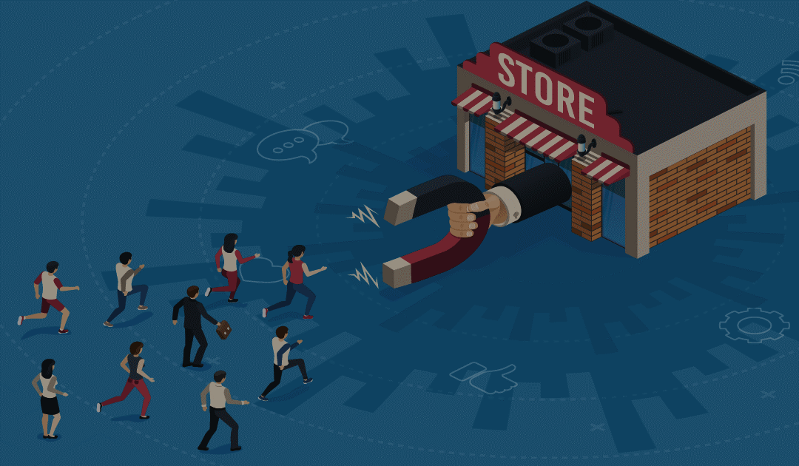
INTRODUCTION
A costumer-driven strategy means shifting focus from a product to its user and basing your marketing strategy, plans and tactics on customers needs and objectives in the first place. As counterintuitive as it may sound, a customer-driven marketing is not as much marketing as customer service.

Slide 4
WHAT IS
CUSTOMER DRIVEN STRATEGY?
A customer driven strategy includes elements like identifying your target market and reacting to their needs. It should also detail ways to retain customers and use them to help you gain additional business.

Slide 5

4 MAIN ELEMENTS OF CUSTOMER DRIVEN:
Target your market.
Meet-customer needs.
Use customer feedback.
Put customers first instead of product.

Slide 6
The customer value
Customer value is the satisfaction the customer experiences (or expects to experience) by taking a given action relative to the cost of that action.

Slide 7
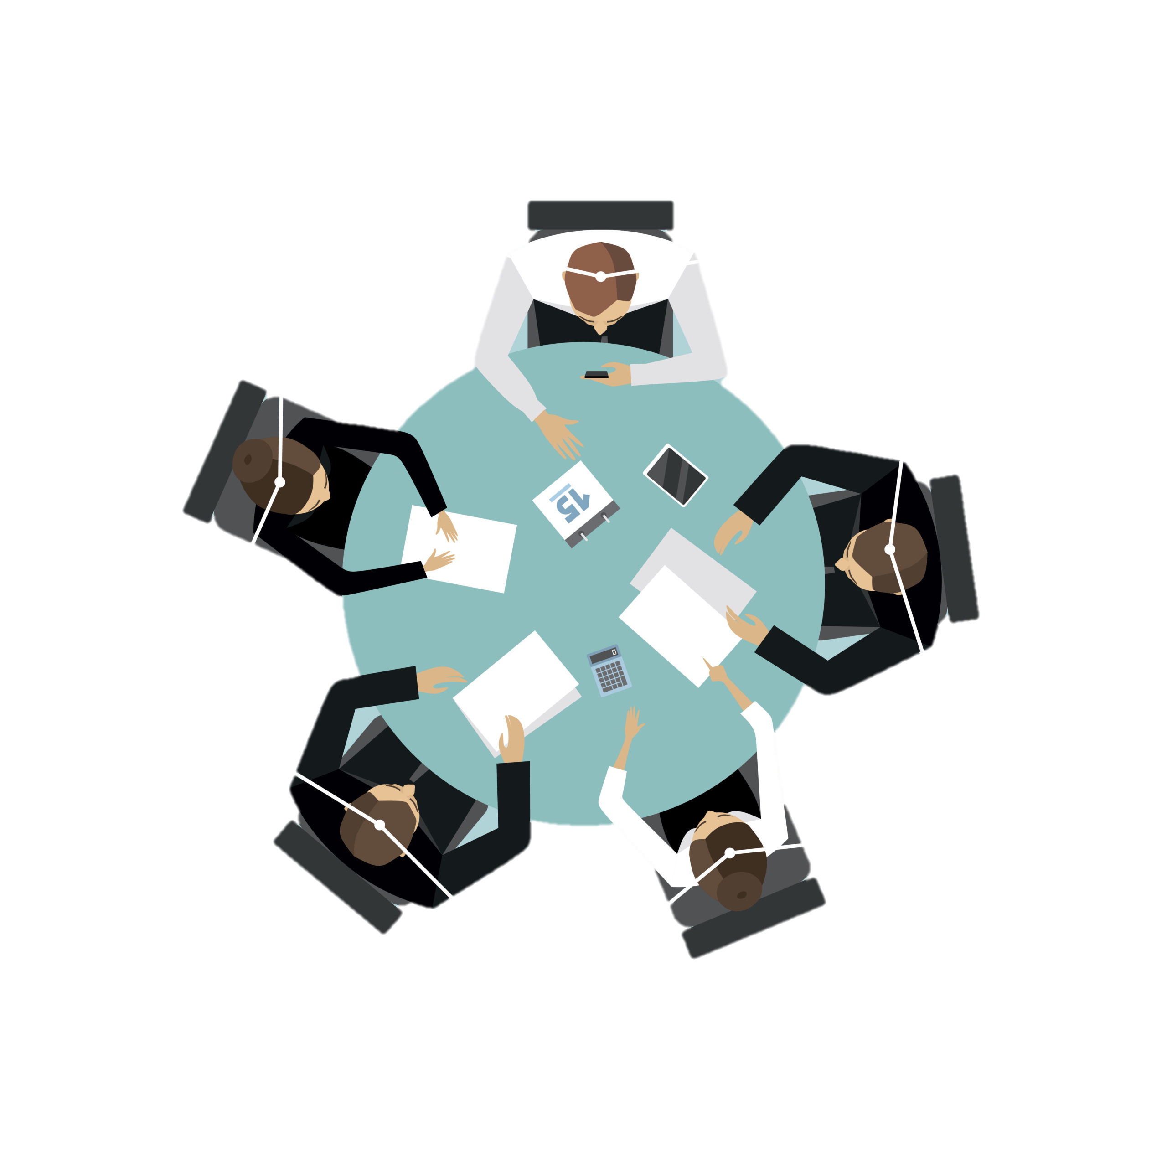
CONCLUSTION
Being customer-driven is about getting the right people to your product and solve the right problems at the right time. Customer-driven is about finding and impressing the people who are ready to spend money and are going to keep spending money.

Slide 8
REFERENCE
Ana Khlystova Jul 02, Khlystova, A., Melnichenko, L., Chernets, N., Kopilevych, D., Says:, A., &amp; Says:, A. (2021, January 24). 5 steps to creating a Customer-Driven marketing strategy. Retrieved April 07, 2021, from https://helpcrunch.com/blog/customer-driven-marketing-strategy/
More than a customer data Platform (CDP). (n.d.). Retrieved April 07, 2021, from http://www.ngdata.com/how-to-creat-customer-driven-marketing-strategy/

Slide 9
Thank You

