Slide 1


Importance Business Ethics
Libyan International Medical University
Faculty Of Business Administration
01
02
03
04
05
06
07
08
09
10
11
12
13
14
15
16
17
18
19
20
21
22
NAME: Monther Almarimi
NO: 2275
EMAIL: monther_2275@limu.edu.ly

Slide 2

Contents
I
II
01
02
03
04
05
06
Introduction
07
08
09
10
11
12
13
14
15
16
The 3 Importance
IIi
Conclusion / References
17
18
19
20
21
22
1

Slide 3
Introduction
01
02
03
04
05
06
07
08
09
10
11
12
13
14
15
16
Business ethics is the study of how a business should act in the face of ethical dilemmas and controversial situations. Business ethics refers to the standards for morally right and wrong conduct in business.
17
18
19
20
21
22
2

Slide 4
The importance of business ethics
01
02
03
04
05
06
Business ethics is an essential skill.
Business ethics drives employee behavior.
Business ethics benefits the bottom line.
07
08
09
10
11
12
13
14
15
16
17
18
19
20
21
22
3

Slide 5
01
Business ethics is an essential skill.
01
02
03
04
05
06
07
08
09
10
11
12
13
14
15
16
17
18
19
20
21
22
4

Slide 6
Almost every company now has a business ethics program. In part, that’s because technology and digital communication have made it easier to identify and publicize ethical missteps. To avoid the negative implications, companies are devoting more resources to business ethics.
01
02
03
04
05
06
07
08
09
10
11
12
13
14
15
16
17
18
19
20
21
22
5

Slide 7
02
Business ethics drives employee behavior.
01
02
03
04
05
06
07
08
09
10
11
12
13
14
15
16
17
18
19
20
21
22
6

Slide 8
Employees are more likely to apply ethical reasoning when their company clearly demonstrates why business ethics is important.
01
02
03
04
05
06
07
08
09
10
11
12
13
14
15
16
17
18
19
20
21
22
7

Slide 9
03
Business ethics benefits the bottom line.
01
02
03
04
05
06
07
08
09
10
11
12
13
14
15
16
17
18
19
20
21
22
8

Slide 10
The term, "Bottom line" has come to mean whatever we will not tolerate, will not do.... no matter what. It is useful for professionals to reflect on their own values and to see if they have an ethical "bottom line"; something you should not do for any reason
01
02
03
04
05
06
07
08
09
10
11
12
13
14
15
16
17
18
19
20
21
22
9

Slide 11

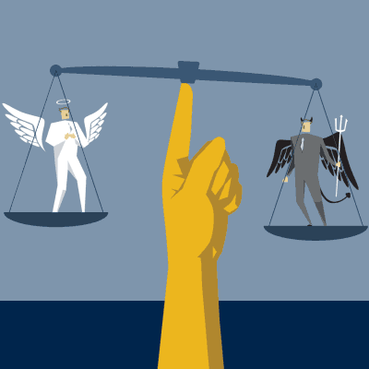
Conclusion
In conclusion business ethics is really important because it focuses on things that makes the company so much better
For example Loyalty , Respect , Equality and Trustworthiness
10

Slide 12
References
https://www.redlands.edu/study/schools-and-centers/business/sbblog/2019/may-2019/3-reasons-why-business-ethics-important/#
( Redlands date accessed :- anuary 23 2021 , date published:- May 09 2019
11

Slide 13

12

