Slide 1


Rights of Shareholders
Libyan International Medical University
Faculty of Business Administration
By: Monther Almarimi
2275

Slide 2
Content
Introduction
Rights of shareholders in corporate governance
Conclusion
References

Slide 3

Introduction
Is an individual or institution that legally owns one or more shares of the share capital of a public or private corporation.

Slide 4


Rights of shareholders in corporate governance
Voting
Inspecting

Slide 5

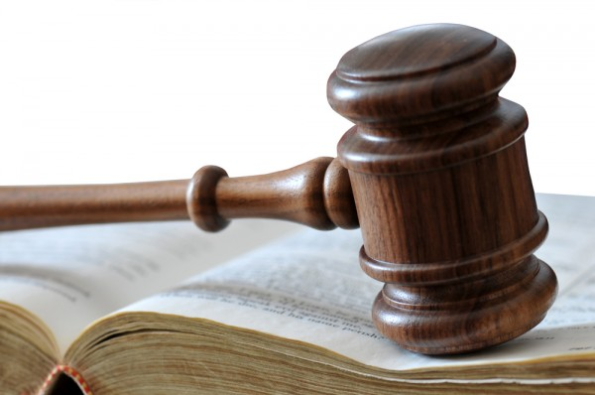
Dividends Entitlement
Rights to Sue

Slide 6
Conclusion
Understanding your rights as a shareholder makes it easier to not break the law under any situation. Shareholders right make the decision making limit of the individuals who own shares in an institution.

Slide 7
References
Shareholder. (2020, December 17). Retrieved December 17, 2020, from https://en.wikipedia.org/wiki/Shareholder
Trust, P. (n.d.). Roles & Responsibilities Of A Company Shareholder. Retrieved December 17, 2020, from https://www.pearse-trust.ie/blog/roles-responsibilities-of-company-shareholder

