Slide 1


Realism Theory
Libyan International Medical University
Faculty of Business Administration
By: Muhaned Gumati
ID: 2510
Date: 22\Jan\2021

Slide 2

Contents
Introduction
The Main Feature of Realism
Conclusion
references

Slide 3

Introduction
Realism is an approach to the study and practice of international politics.

Slide 4
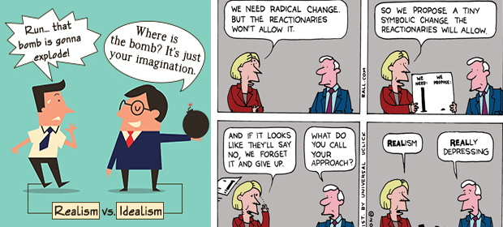
The Main Feature of Realism
Realism is a theory that claims to explain the reality of international politics. It emphasizes the constraints on politics.

Slide 5
Types of Realism
Human nature: Realists view human beings as inherently egoistic and self-interested to the extent that self-interest overcomes moral principles.
state-centric: view sovereign nation-states as the only legitimate monopolist over the use of force, which focuses solely on state behavior.

Slide 6
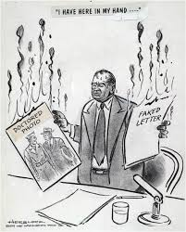
Conclusion
Political realism is a theory of political philosophy that attempts to explain, model, and prescribe political relations.

Slide 7
Reference
(n.d.). Retrieved January 22, 2021, from https://iep.utm.edu/polreal/

Slide 8


