Slide 1


Suppliers & Competitors
Libyan International Medical university
Faculty of Business Administration
By: Sanad Nagem 2232

Slide 2
CONTENTS
Introduction
Stakeholders
Suppliers as Stakeholders
Competitors as Stakeholders
Conclusion

Slide 3
01
Introduction

Slide 4

Suppliers
Are businesses that sell products or services that involve the development or accomplishment of their targets by a corporation or sector.
Competitors
They are corporations, teams, or groups that work against you or your company.

Slide 5
02
Stakeholders

Slide 6


IN DEPTH
MARS
MERCURY
VENUS
JUPITER
VENUS
Venus has a beautiful name and is the second planet from the Sun. It’s terribly hot—even hotter than Mercury—and its atmosphere is extremely poisonous. It’s the second-brightest natural object in the night sky after the Moon
If you want to modify these graphs, click on them, follow the link, change the data and replace them

Slide 7
03
Suppliers as Stakeholders

Slide 8
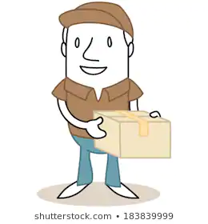
Suppliers as Stakeholders
Suppliers supply the raw materials or parts used by a business to manufacture its goods.

Slide 9
04
Comprtitors as Stakeholders

Slide 10
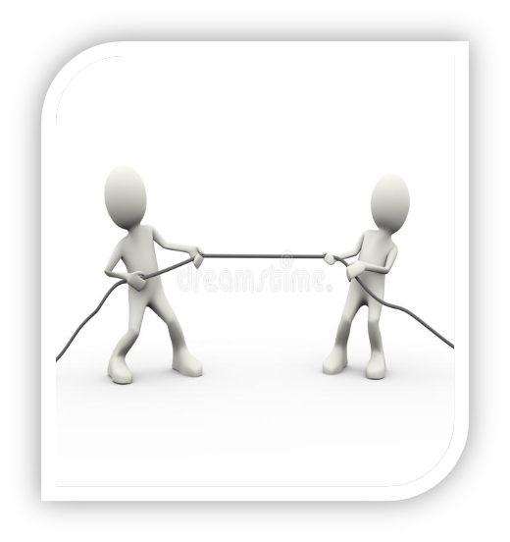
Competitors as Stakeholders
To enhance and change their own market plan, the rival has a stake in the company's expertise.

Slide 11
Conclusion
Suppliers are the ones who supply raw materials to businesses.
Competitors are those who try to surpass a business.
Stakeholders everybody who has an interest in the actions of an organization.
Suppliers can affect, and are affected to whom they supply.
Competitors are good to ensure quality.

Slide 12
References
Stakeholder - Learn About the Different Types of Stakeholders. (2020, March 23). Retrieved January 14, 2021, from https://corporatefinanceinstitute.com/resources/knowledge/finance/stakeholder/
Wroblewski, M. (2019, August 22). How Is a Competitor a Stakeholder? Retrieved January 14, 2021, from https://yourbusiness.azcentral.com/competitor-stakeholder-24680.html
What are stakeholders? - Stakeholders - GCSE Business Revision - Other - BBC Bitesize. (n.d.). Retrieved January 14, 2021, from https://www.bbc.co.uk/bitesize/guides/z4gcd2p/revision/1

