Slide 1


Scope of business ethics
Libyan International Medical University
Faculty of Business Administration
By: SANAD NAGEM
2232

Slide 2
Introduction
Ethics
Scope of business ethics management
Conclusion
References
Contents

Slide 3
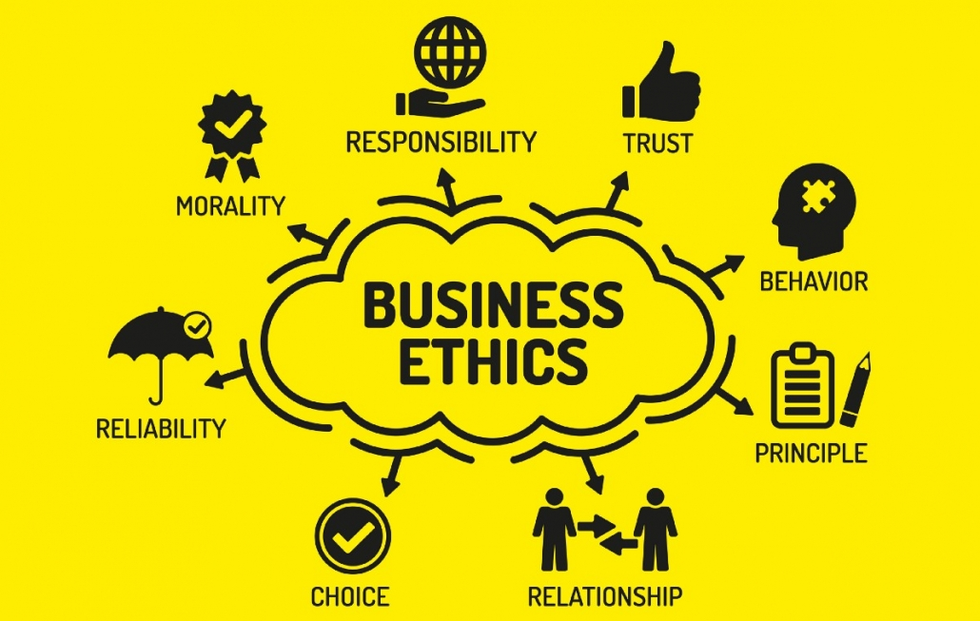
Introduction:
“Business ethics is a social science, whose main aim is to define and examine the responsibilities of businesses and their agents as a part of the general moral environment of a given society”.

Slide 4
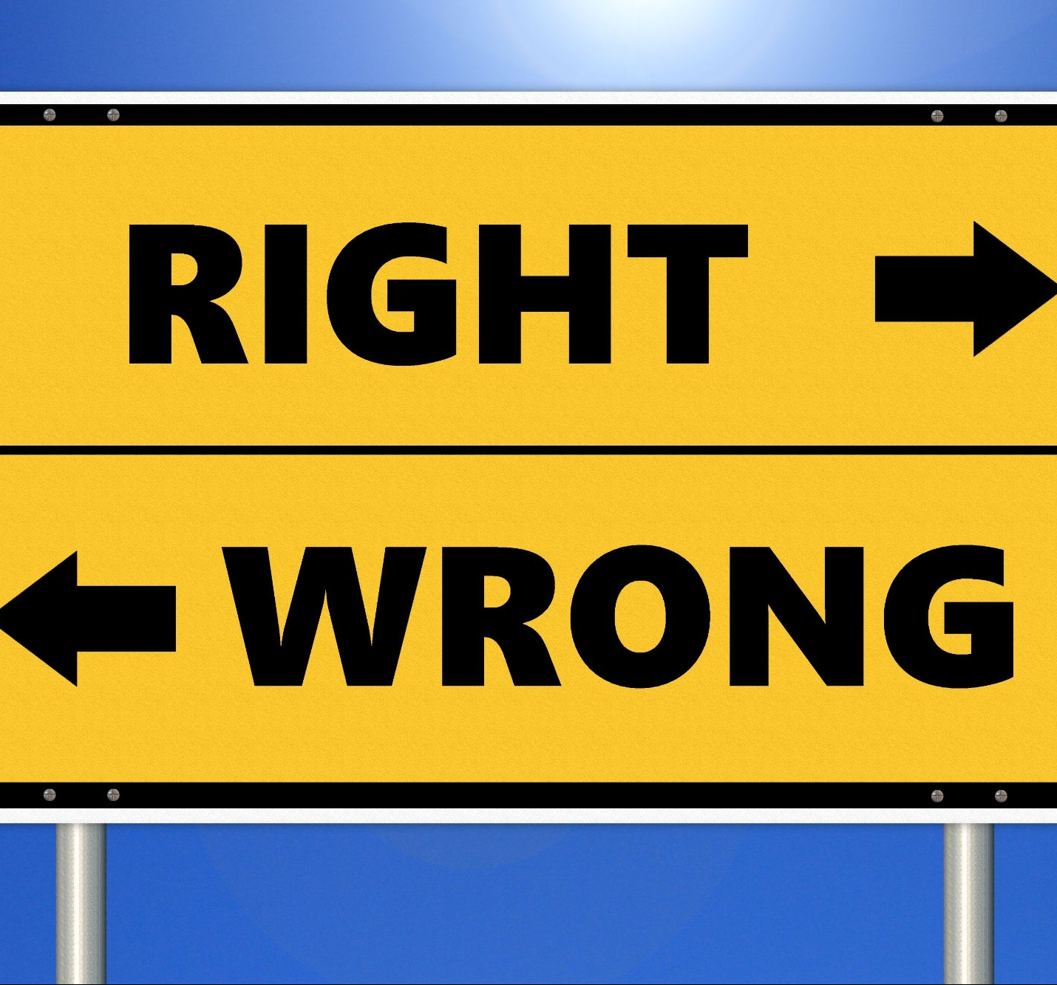
Ethics
Ethics is a branch of social science. It deals with moral principles and social values.

Slide 5
Scope of business ethics:
Ethics in compliance: Is to obey the rules and regulations.
Ethics in finance:
In accounting –misleading financial analysis.
Securities fraud leading to manipulation of the financial markets.
Bribery, kickbacks, over billing of expenses
Fake reimbursements

Slide 6


3. Ethics in Human resource: Focuses on the issues arising around the employer-employee relationship.
4. Ethics in marketing: Focusses on the moral principles behind the operation and the regulations of marketing.

Slide 7
Conclusion
Ethics is the foundation of society. If it is well built then our society will not fall. Ethics should be practiced all over the globe of everyone's benefit.

Slide 8
References:
Twin, A. (2020, August 28). Business Ethics: Fair Business Policies Within Controversial Subjects. Retrieved December 3, 2020, from https://www.investopedia.com/terms/b/business-ethics.asp
Kumar, A. (2020, August 12). Business Ethics: Nature and Scope. Retrieved December 3, 2020, from https://amitiitism.wordpress.com/2015/03/25/business-ethics-nature-and-scope-college-assgn-01/

