Slide 1


Consumers as Stakeholders
Libyan International Medical University
Faculty of Business Administration
By: Sanad Nagem 2232

Slide 2

Contents
Introduction
1
Consumers as stakeholders
2
Conclusion
3

Slide 3

Introduction!
A customer is an individual or group planning to buy, order or use the goods, items or services purchased, mainly for personal, social, family, household or similar purposes, and not specifically connected to business or entrepreneurial practices.

Slide 4
Stakeholder
Any person, group, or party who has an interest in an entity and the effects of its operations is a stakeholder.

Slide 5
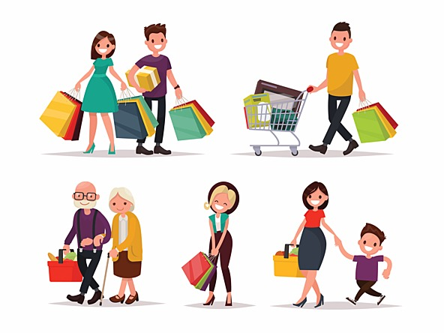
Consumers as stakeholders
Consumers are the core of a business, they affect the business in many ways, as they get affected by it. Consumers is what helps businesses keep open.

Slide 6
Conclsuion
Stakeholders include employees, managers, customers, owners, suppliers…… .
Consumers are the purpose of every business.
A consumer can affect, and is affected by any business.

Slide 7
References
Stakeholder - Learn About the Different Types of Stakeholders. (2020, March 23). Retrieved January 07, 2021, from https://corporatefinanceinstitute.com/resources/knowledge/finance/stakeholder/
Consumer. (2020, December 27). Retrieved January 07, 2021, from https://en.wikipedia.org/wiki/Consumer

