Slide 1


Ethical Issues and Problems Dealing With its Suppliers and Competitors
LIBYAN INTERNATION UNIVERSITY
FACULTY OF BUSINESS ADMINSTRATION
By: Yousef kikhia
Student ID: 2762

Slide 2
CONTENT
Supplier and competitors as a stakeholder
Ethical issues with suppliers
Ethical issues with competitors
conclusion

Slide 3

Suppliers as a stakeholder
As we all know contracts between businesses and their suppliers often involve substantial sum of money, which can mean differences business survival and failure. Thus when considering issues of money and suppliers, the issues of trust, bribery, thief, overpricing etc.
suppliers together with other stakeholders such as competitors, customers, regulators, and strategic allies are part of the organization’s Task Environment within the external environment. They directly affect a particular organization but they are not part of the organization.

Slide 4

Competitors as a stakeholder
While our competitors are seen as threat to our business survival does not mean we forget about them when it comes to business ethics.
an organization’s competitors are other organizations that compete with it for resources. The resource most commonly competed for is customer dollar. No all competition can be expressed in terms of customer dollar.

Slide 5
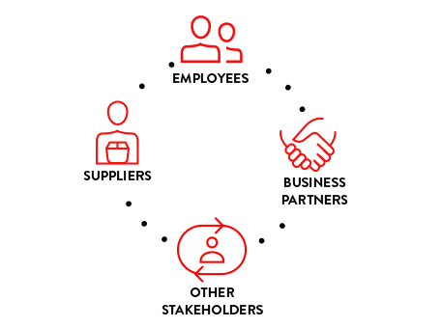
Ethical issues and suppliers
Misuse of power
Preferential treatments
Question of loyalty
Gifts bribes and hospitality

Slide 6

Ethical issues and competitors
insufficient competition
Overly aggressive competition
Private or Confidential information
Dirty tricks

Slide 7
Conclusion
We should keep in mind that organizations and their suppliers are mutually dependent on each other for their own success; just as suppliers rely on their customers for orders which keep them in business.
Competitors have moral and ethical considerations when it comes to doing business activities and also the rights to privacy. Some organizations track their competitors more closely than others.

Slide 8
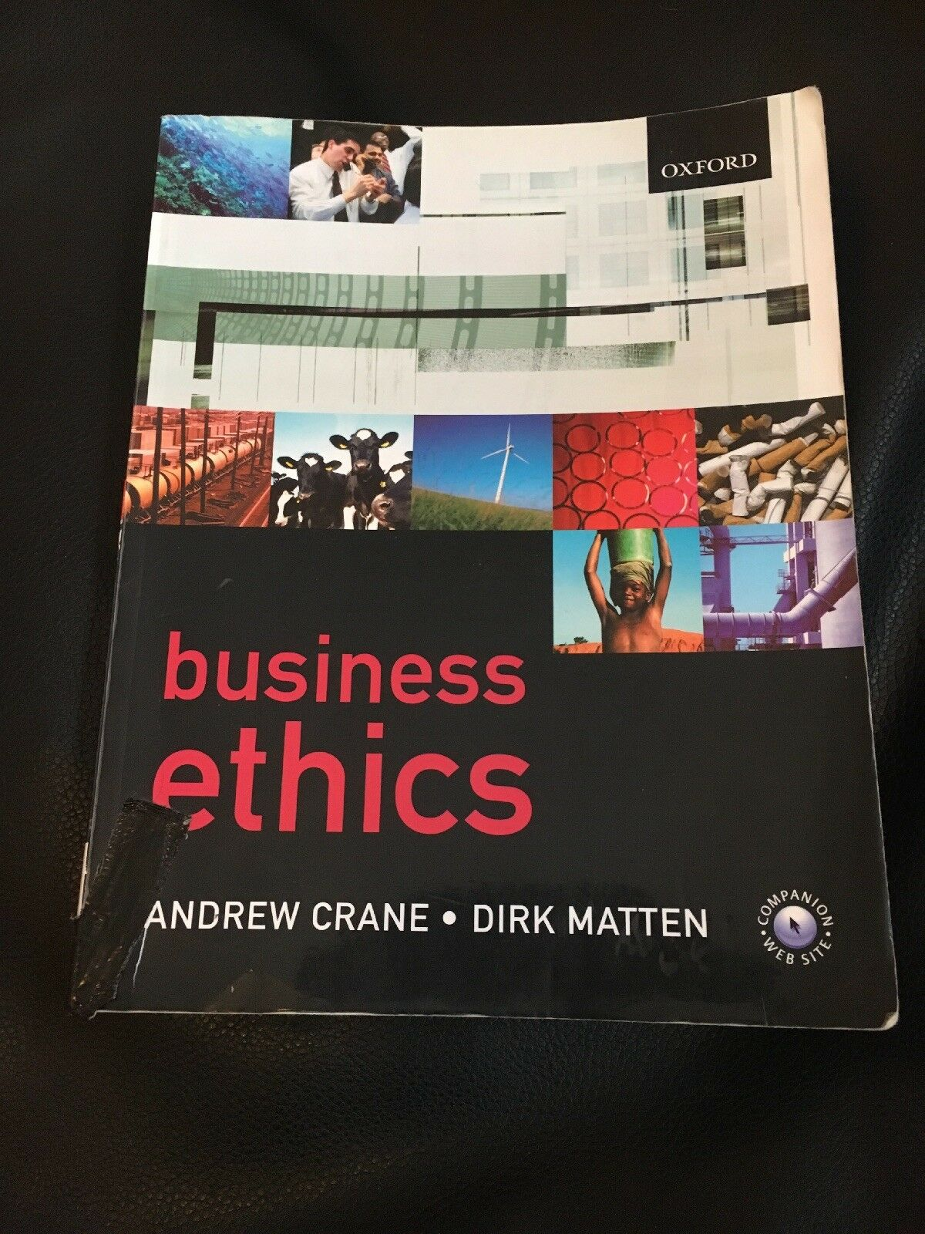
REFERENCE
Andrew Crane and Dirk Matten, 2007 Business Ethics Second Edition.
Nickel, McHugh, McHugh, (2005) Understanding Business 7th Edition, McGraw-Hill.
Johnson, Abramov, Business Ethics 2004, “A Publication of the Good Governance Program” International Trade Administration Washington D.C. 2004

Slide 9


