Slide 1


The Various Ways to Be Culturally Aware
Libyan International Medical University
Faculty of Business Administration
Omar Bubtana
2770
Omar_2770@limu.edu.ly
1

Slide 2
Content
How to be Culturally Aware
Tips from the American Psychological Association to be More Culturally Aware
Conclusion
2

Slide 3
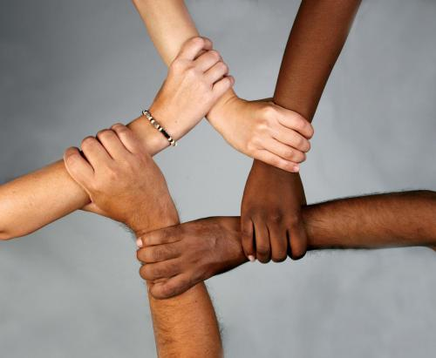
Think Beyond Race and Ethnicity
3

Slide 4

Learn By Asking
4

Slide 5

Make Local Connections
5

Slide 6
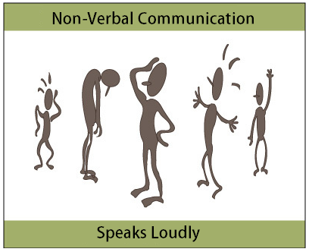
Pay Attention to Non-Verbal Behavior
6

Slide 7

Exchange Stories
7

Slide 8
Conclusion

Slide 9
References
Kapil, R. (2019, July 23). Five Ways to be More Culturally Aware. Retrieved December 06, 2020, from https://www.mentalhealthfirstaid.org/2019/07/five-ways-to-be-more-culturally-aware/?fbclid=IwAR1T1U-9Io4mOvzq74r4uLQnGdgulVlcMpG0gCJCZE32J_KWq5yDLpp7-_s
8

Slide 10
THANK YOU!
9

