Slide 1


Reasons for Public Enterprises
Libyan International Medical University
Faculty of Business Administration
Or Public Corporation
Student name: Saad Bensoud
Student id: 2732
E-mail: saad_2732@limu.edu.ly

Slide 2
Content :
Public Enterprise
Some reasons for establishing public enterprise
Conclusion
References

Slide 3
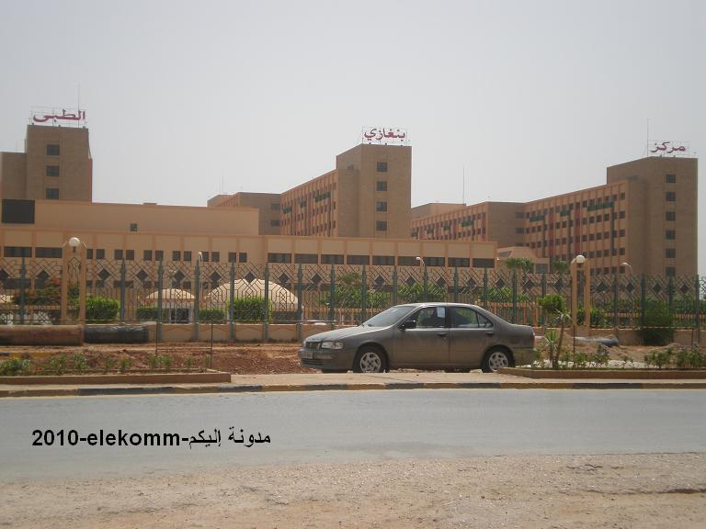

Public Enterprises
Public Corporation can be defined as business organizations or enterprises set up, controlled and managed by the Government in order to provide goods and services to the members of the public.

Slide 4
Reasons for Government ownership of Public Corporation

Slide 5

1. Creation of Employment Opportunities
Government ownership of Public corporation helps in creating employment opportunities for the teaming unemployed persons in the society.

Slide 6

2. Economic Growth
This is ensured through Government ownership of some organizations

Slide 7

3. Capital
The capital requirement for the establishment of a public corporation is so large that it could not have been easy or even possible for private individuals to raise

Slide 8

4. Prevention of competition
There is the need for government to prevent unhealthy competition in some very important industries. The government has the role and duty to ensure the success of such corporations in the interest of the public

Slide 9

5. To Prevent Exploitation
The aim of any private investor is to maximize profit but there are some social responsibilities in which the government owes to its people, if private enterprises are allowed to handle the provision of most of the essential goods and services, there would be high level of exploitation

Slide 10
Conclusion

Slide 11

References :
Various Reasons for Government Ownership of Public Corporation. (2014, October 10). Self-Help Archive. https://selfhelparchive.com/various-reasons-for-government-ownership-of-public-corporation/
Owen E.Hughes, Public Management and Administration, p 92.

Slide 12


