Slide 1


The State and the Government
Libyan International Medical University
Faculty of Business Administration
Name : Saad Bensoud
Student ID: 2732
Email : saad_2732@limu.edu.ly
1

Slide 2
TABLE OF CONTENTS
01
The state
02
The Government
03
The difference between them
04
Conclusion
05
References
2

Slide 3
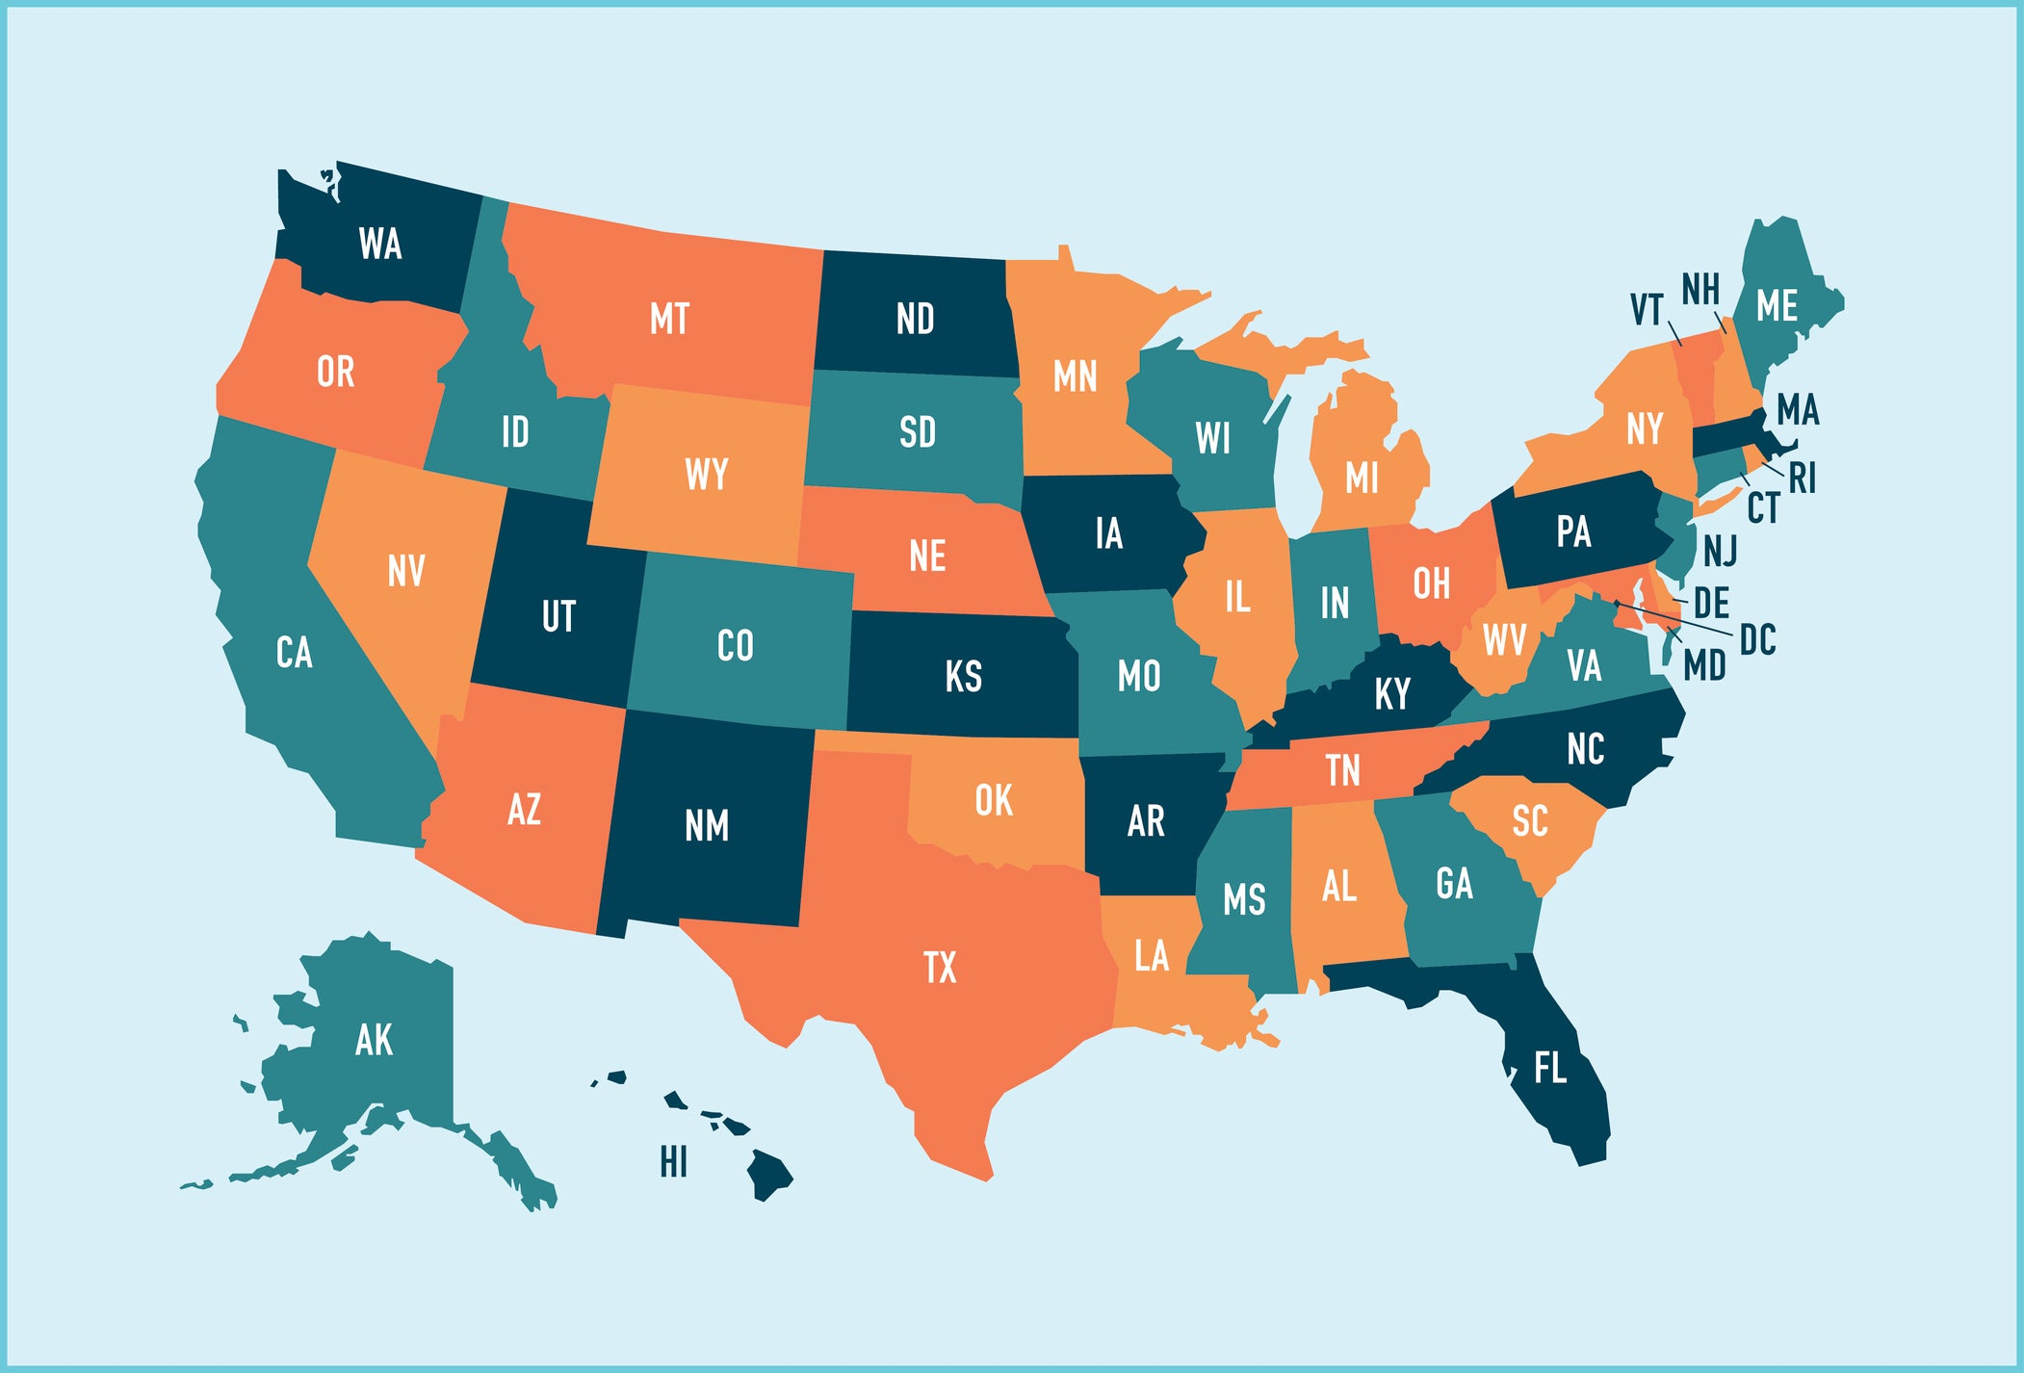
The state
3

Slide 4
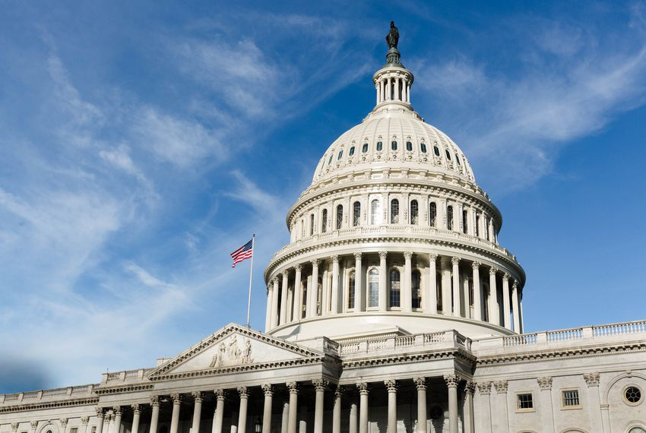
The Government
4

Slide 5
The main differences between the state and the government
5

Slide 6
Government is only an element of the state
6

Slide 7
State is Permanent, Government is Temporary
7

Slide 8
Government is organized only by a portion of the population of State
8

Slide 9
State is Abstract , Government is concrete
9

Slide 10
You can not go against the state; Yes the government
10

Slide 11
Conclusion

Slide 12
References
Green, G. (2017, April 29). What are the Differences Between State and Government? Life Persona. https://www.lifepersona.com/what-are-the-differences-between-state-and-government
B. (2017, October 16). Difference between State and Government. Difference Betweenz. https://differencebetweenz.com/difference-between-state-and-government/

Slide 13
THANKS!

Slide 14


