Slide 1


Understanding the scope of Business Ethics Management
Libyan International University
Faculty of Business Administration
Weaam Fadel
Student ID: 2870
Email: weaam_2870@limu.edu.ly

Slide 2
Table of Content
Essentiality of business ethics
Employee management ethics
Foundation of managerial ethics
Elements of managerial ethics
Conclusion
References

Slide 3
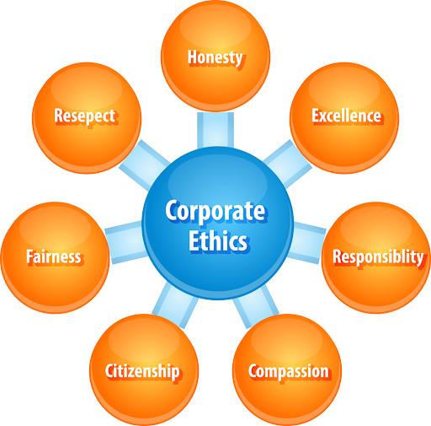
Businesses are run efficiently when principles and rules are set. These rules help the businesses to know how to act in difficult scenarios. Ethics are therefore the foundation for any business.
Essentiality of business ethics

Slide 4

Employee Management Ethics
Employee management ethics starts with hiring methods and ends with firing practices within the organization. During employment all matters pertaining to the overall treatment of employees is relevant to the proper conduct of the business.
Ethical hiring practice entails assessing each candidate according to his or her capabilities and potential value to the company, rather than discriminatory or other superficial considerations.

Slide 5
The foundation of Managerial Ethics
Any business, to be successful, it needs to have a strong foundation of managerial ethics. These managerial ethics are built upon the four key elements, which are:
A strong code of ethics
Training in ethics
Confidential reporting system
Ethics coach

Slide 6
1. Training in ethics
Many companies have their own in-house training departments. These departments can provide the necessary requisite training required by employees

Slide 7
2. Strong code of ethics
This means that there should be a code which every employee can follow and strive on

Slide 8
3. Confidential reporting system
This helps employees report any type of misconduct or violation at the workplace

Slide 9
4. Ethics coach
Just as the employees require trying in ethics there should also be a person who’s friendly and will be available for any issues related to ethics

Slide 10
Conclusion
To sum up, business ethics management is the main pathway to a fair and triumphant business. Ethics is a vital component in running a business. Without business ethics the business will not run efficiently, successfully and will most likely fail.

Slide 11
References
Retrieved from:
3 years ago Editorial, Editorial, Editorial See author's posts, Posts, S., 10 months ago Editorial, 2 years ago mibrand Magazine, . . . *, N. (2019, February 26). Six Scopes of Ethics in Business Management. Retrieved December 03, 2020, from https://mibrand.my/six-scopes-of-ethics-in-business-management/3 years ago Editorial, Editorial, Editorial See author's posts, Posts, S., 10 months ago Editorial, 2 years ago mibrand Magazine, . . . *, N. (2019, February 26). Six Scopes of Ethics in Business Management. Retrieved December 03, 2020, from https://mibrand.my/six-scopes-of-ethics-in-business-management/
Managerial Ethics: Key Elements of Business Ethics, Importance, Videos. (2018, December 04). Retrieved December 03, 2020, from https://www.toppr.com/guides/business-communication-and-ethics/business-ethics/essential-elements-of-business-ethics/

Slide 12
Thank you

