Slide 1


Identifying the Historical Development of Political Science
Libyan international university Faculty of Business Administration
By Weaam Fadel
Student ID: 2870

Slide 2
01
TABLE OF CONTENTS
02
ANCIENT INFLUENCES
EARLY MODERN DEVELOPMENTS
03
04
19th CENTURY ROOTS OF CONTEMPORARY POLITICAL SCIENCE
POST WORLD WAR II TRENDS AND DEBATES

Slide 3
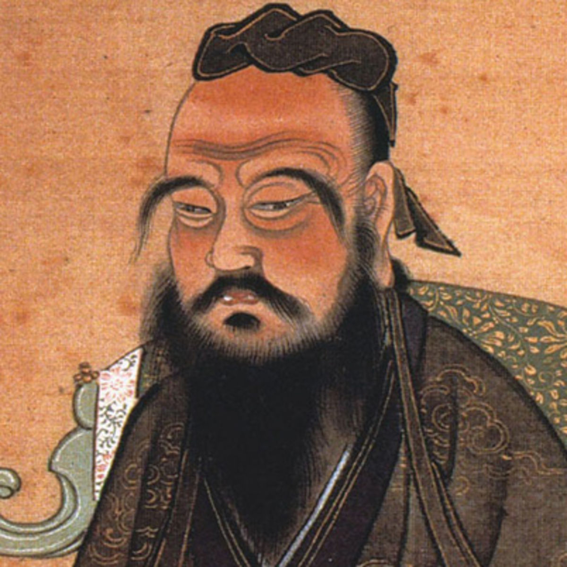
Ancient Influences:
Confucius ( 551 - 479 BCE)

Slide 4
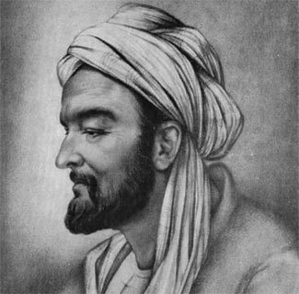
Ibn Khaldun (1332 - 1406)

Slide 5
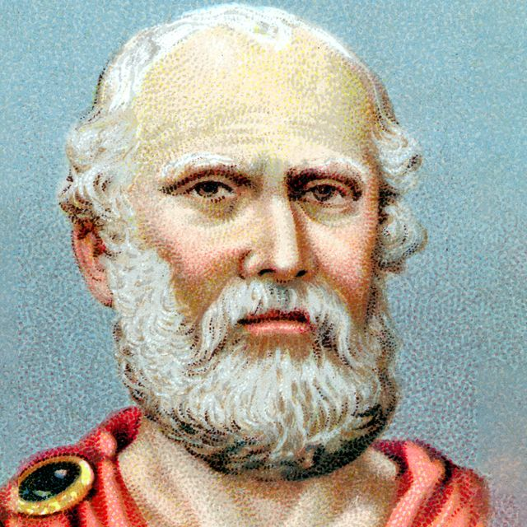
Plato (428 - 427 - 348/347 BCE)

Slide 6
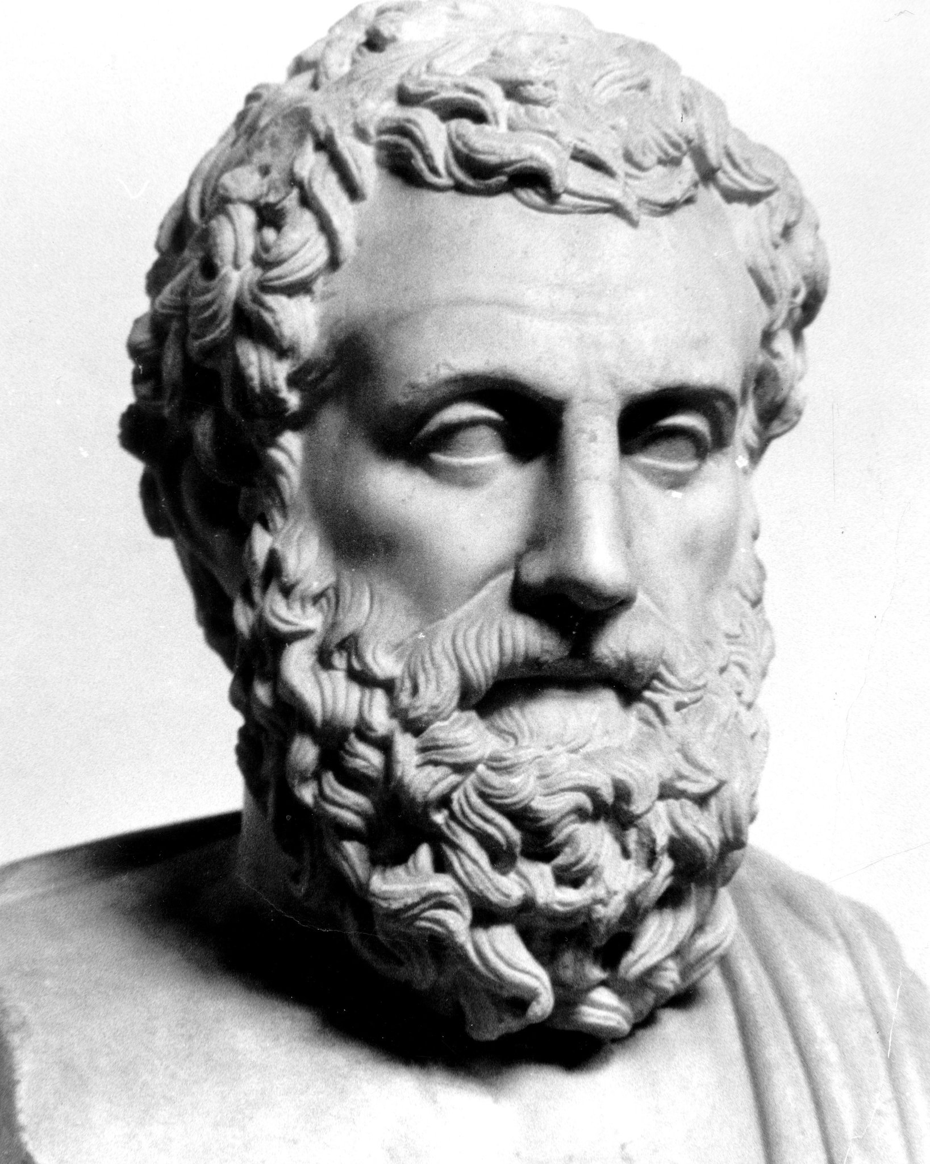
Aristotle (384 - 322 BCE)

Slide 7
Early modern developments:
The first modern political scientist was the Italian writer Niccolo Machiavelli (1469 - 1527). His political philosophy, which completed the secularization of politics begun by Maesilius, was based on reason rather than religion.

Slide 8
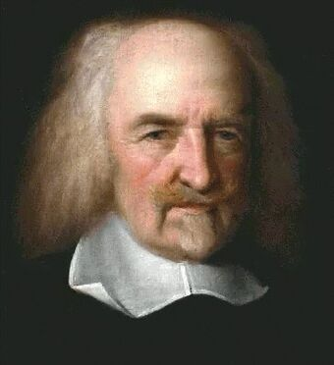
The English philosopher Thomas Hobbs also placed power at the center of his political analysis.

Slide 9
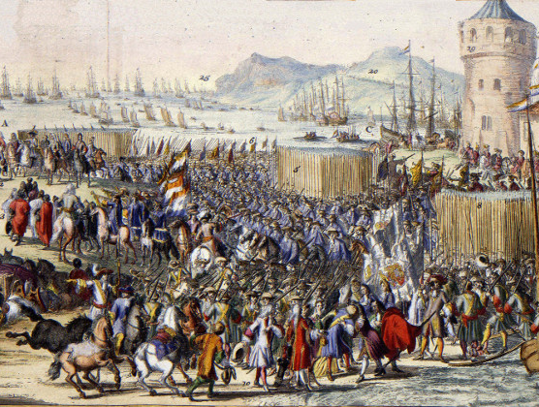
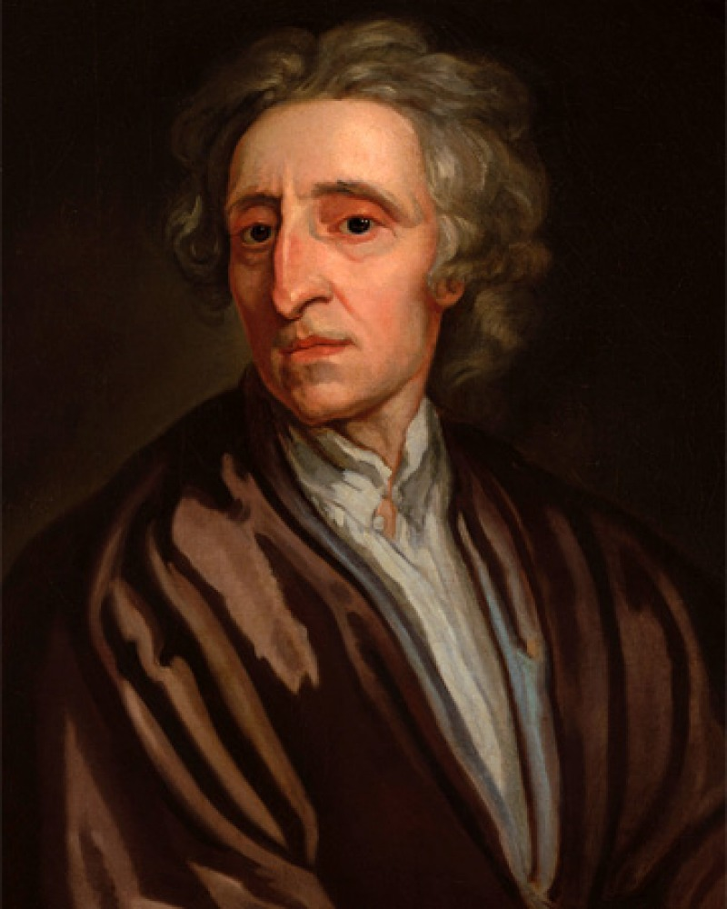
English philosopher John Locke (1632 - 1704) who also witnessed the turmoil of an English civil war - the Glorious Revolution argued that people form governments to preserve their natural rights to life, liberty & property and that any government that fails to secure natural rights should be overthrown.

Slide 10
19th Century roots of contemporary Political Science
Contemporary political science traces its roots primarily to the 19th century when the rapid growth of the natural sciences stimulated enthusiasm for the creation of a new social science.

Slide 11
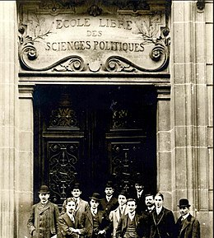
The first separate school of political science was established in 1872 in France as the Ecole Libre des Sciences Politiques (now the Institut d’Etudes Politiques).

Slide 12
Post - World War II trends and debates
The most important irreversible change in political science after World War II was that the scope of the discipline was expanded to include the study of politics in Asia, Africa and Latin America - areas that had been largely ignored in favor of Europe & North America.

Slide 13
Conclusion
As a social political science, contemporary political science started to take shape in the later half of the 19th century. At that time it began to separate itself from political philosophy, which traces its roots back to the works of Aristotle and Plato, which were written nearly 2,500 years ago. The history of political science serves as a context within which we make sense of the nature and role of our discipline.

Slide 14
REFRENCES:
Department of Political Science. (n.d.). Retrieved November 29, 2020, from https://www.polisci.washington.edu/search/google/citationDepartment of
Political Science. (n.d.). Retrieved November 29, 2020, from https://www.polisci.washington.edu/search/google/citation

Slide 15
Thanks!

